Slide 1
Junior Development Plan
‘The Mudgee Way’
Junior Development Plan

Slide 2
Junior Development Plan
“Football players are like
ARTISTS,
The field is their canvas,
Let them paint their own
MASTERPIECE.”
Jason Maguire

Slide 3
FGC Football Philosophy
The Mudgee JDP
Road Map for Development
The Mudgee JDP is designed to provide junior football administrators, board members, and coaches with a simple and clear player development road map. Successful junior football organizations work from a central vision and philosophy that is supported by an engaged club administration, educated coaching staff, and a professional player development model.
The Club plays an important role in the day-to-day development of all players. A player centred development philosophy will foster positive first experiences within the game. This leads to inspired players who have a passion for learning and will ultimately fall in love with the game. This philosophy combined with a well-structured coaching plan and organizational goals will create a platform for continual long term success. The Mudgee Way will be your road map to success……
Welcome to Mudgeeraba Soccer Club

Slide 4
Vision – Where we want to be!
To develop and implement the leading youth football development program in FGC. We also wish to be recognized for our style of football and playing philosophy, know as… The Mudgee Way
We will achieve this vision by:
Implementing the FFA National Curriculum and The JDP (across all junior teams)
Maintaining a club philosophy and policy of development
Recruiting and developing experienced and qualified coaches with an aligned coaching philosophy and values
Focusing on core Club Values which are just as important off the football pitch and in life as they are on the football pitch
Adhering to a playing style and philosophy of ‘creative, and positive possession base football’,
This will be achieved by implementing “THE JUNIOR DEVELOPMENT PLAN” at all junior levels of the club
Junior Development Plan

Slide 5
Junior Development Plan
CLUB CULTURE
Loyalty - devotion · your club
Inspire – people through positive actions
Integrity - good character · morals
Opportunity - your chance · your opportunity · your moment
Success - development

Slide 6
Junior Development Plan
CLUB VALUES
Respect! Yourself – Others !
Trust! Our belief and faith will lead to success!
Open communication!
Engagement! Sharing a responsibility is not dividing it, but multiplying it!
Positive! Think – Act – Be positive!
Honesty! In words – acts – feelings – thoughts!
We will actively support families;
We will be inclusive in our approach (multi-cultural)
Self-awareness! Know your strengths and weaknesses!
Learning attitude! Mistakes are lessons
Passion! For achievement – knowledge – life – play!
Team! No single individual is bigger than the CLUB as a whole!

Slide 7
Junior Development Plan
Playing Style

Slide 8
Junior Development Plan
Playing Style
“A pro-active brand of Football, based on effective possession with the cutting edge provided by creative individuals.
Defensively the key components are quick transition and intelligent collective pressing.
The Playing Style is underpinned by a strong ‘team mentality’, capitalising on Australia’s traditional strengths.

Slide 9
Playing Style
Junior Development Plan
Introduce a uniform playing style and coaching style in order to develop
skilful and creative players.
A creative possession based style of play is the best guarantee of learning and development. To develop creative players, freedom of expression is key.
Players need to learn from their mistakes and should always be encouraged to try again. If young players are criticised for losing the ball, or discouraged from trying something new, they will not learn.
Our philosophy sees the 1-4-3-3 system of play as the best format in which to develop young players. Within this formation, roles can be clearly outlined and there is a greater set of options for passing, ball retention etc which facilitates learning and provides flexibility in attacking and defending. This system of play can be played in different formats as the best approach for player development.
Coaches should encourage young players to play out from the back, through midfield, linking up with attack. Whilst the long-ball can be effective, it is no longer considered the only method of attacking play.

Slide 10
Junior Development Plan
Attacking in the 1-4-3-3
All teams will be encouraged to display an Attacking style of play based on keeping effective possession and quick movement of the ball.
Based on ball possession and clever player movement. COMPONENTS Forward and penetrative passing, calculated and measured. Play out from the defending third as a primary option. Progress through the MF third as first priority. Rotation and inter-change of players as appropriate. MF players forward runs and support play. Create optimum marking problems for opponents.
Utilise wide attacks (Wingers and Full backs) to outflank and attract opponents from central areas. Use central striker as focus in penetrating the opposition back line. Enter the Penalty box from varied angles.
Back and MF players to establish tempo & style of play.
Delayed counter attack. Secure possession and build with incision.
Position specific
A team must be organized defensively, keeping their specific positions in the formation (BPO). However, when in BP players will look for space and time their movements to support our attacking options by moving away from their original positions (BP).

Slide 11
Junior Development Plan
1-4-3-3 DEFENDING TACTICS.
Regain ball possession as “early” as possible when appropriate. Concede possession only when opponents establish composed possession in their defending half of the pitch and we are out-numbered. Recover, re-group on losing possession if pressing not tactically appropriate. Compact defensive unit before “team” pressing commences and continues. Establishing a “first” defending line around the AM 1/3rd area and deeper.
Controlled aggressive defending commences from that defending line to protect the defending third shooting and crossing areas.
“Show” opponents in possession “infield” as a tactical priority,
Allow no “un-coverable” space behind the back defending line.
Mark “key” opponents in and around the penalty area as play develops.
Mark and press “key” opponents who are essential to opponents supply lines in developing play.
Players in isolation, and units when dislocated, should be capable of defending Counter attacks.
Prevent wide and central entries into the penalty box as a priority.
‘Pro-active’ or ‘re-active’?
Proactive players alert to the team.
Proactive team alert to the game.

Slide 12
Junior Development Plan
The key elements for coaches and players that define the style of play
The skill and ability to consistently build from the back through a short passing game
All players attack and all players defend: All players must be involved in the game as a unit.
Numerical advantage: Football is a game of numbers where we try to create a numerical advantage in attack and avoid being in a numerical disadvantage in defence. (Overload)
Flow of the ball: The ball should flow from inside (of the space) to outside and outside to inside. Balls out wide are more secure and the ball in the middle increases the options of play.
Triangle principle and passing options: The player in possession of the ball must receive constant support and have at least two passing options.
Speed of play: Quick movement of the ball creates 1v1,2v1 situations.
Movement off the ball: Find the best available space to create passing options for the player in possession of the ball. (Every pass has a Purpose)
Pressure as a unit: Organized pressure forces the opponents to commit errors.
Transition: Improve transition by reducing the number of passes needed to arrive at the target area or the opponent’s goal.
Direction of the game: The game flows in two directions. Keep the essence of the game in the majority of your practices.
Take initiative during the game: Team breakdowns will occur. The team must be capable of adapting to new situations and imposing its own style of play during the game.

Slide 13
Junior Development Plan
PRINCIPLES OF PLAY

Slide 14
PRINCIPLES OF PLAY
TRANSITION
TRANSITION: Lost the Ball (BP-BPO) 6 Second Regains
On transition of losing possession, our players actively ‘hunt’ for the ball (often in pairs) for the first 6 seconds of losing possession before the opposition are able to make the pitch big and move the ball into space. If the ball isn’t regained after 6 seconds, the team shall seek to find defensive balance and compactness
The Football Way Principles of Play define the style of football our teams play and provide the backdrop for our coaching program throughout all age-groups.
BALL POSSESSION OPP
Making Play Predictable
Working as individuals and compact units without the ball to force the opposition backwards or sideways, away from playing penetrating forward passes and eventually forcing errors and mistakes
Pressing From The Front Our teams will attempt to win the ball back high up the pitch with the first line of defence being our attackers. 11 a-side teams will press upfront as a unit of four when playing 1-4-3-3.
BALL POSSESSION
High Tempo Possession Based Football An overall style of play based on dominating possession of the ball by passing and moving quickly at a high tempo.
Playing Out From The Back All of our teams will attempt to play a possession based game from within our own defensive third of the pitch to build play into both the middle third and attacking third.
TRANSITION: Regained the Ball (BPO-BP)
Counter Attack Our teams will attempt to launch quick and incisive counter-attacks following regains (often in our defensive and middle third) with the aim of reaching goal in 10 seconds or less.

Slide 15
OUTCOME | PRINCIPLES OF PLAY
OBJECTIVES | SCORE GOALS |  | PREVENT GOALS |  |  | SCORE/PERVENT GOALS
METHODS | GET THE BALL AND YOUR PLAYERS INTO GOALSCORING POSITIONS |  | PREVENT THE OPPONENT GETTING THE BALL AND THEIR PLAYERS INTO GOALSCORING POSITIONS |  |  | GET YOUR PLAYERS INTO POSITIONS TO SCORE/PERVENT
MAIN MOMENTS | BPO>BP | BP | BP>BPO |  | BPO | SET PLAY
KEY PRINCIPLES | Immediate transition into BP positions | Effective Possession 1. Structured Build-Up | Immediate transition into BPO positions |  | Win the ball back as soon as possible | Defending CK/FKs
 | Quick forward passing | Effective Possession 2. Controlled Possession In The Middle Third | Press the ball carrier immediately |  | Deny opponents time and space to build up | Limit opponents’ ability to create scoring chances
 | Quick forward movement | Combination Play 1. Organised Opponent | Limit opponent’s passing options |  | Limit opponents’ ability to create scoring chances | Attacking CK/FKs
 | Make the field as big as possible | Combination Play 2. Disorganised Opponent | Make the field as small as possible |  |  | Can we create scoring chances
 |  | Individual Skill 1. To create scoring chances |  |  |  | Transition from SP
 |  | Individual Skill 2. To convert scoring chances |  |  |  | Man Marking or Zonal Marking
TEAM TASKS | (Fundamental Tasks to make the Key Principles happen)
PLAYER TASKS | (General and Position-specific)
PLAYER ACTIONS | Positioning, First Touch, Running with the Ball, 1v1, Striking the Ball, Communicating |  |  | Positioning, Pressing, Marking, Intercepting, Tackling, Communicating |  | Positioning, Marking, Intercepting, Tackling, Communicating

Slide 16
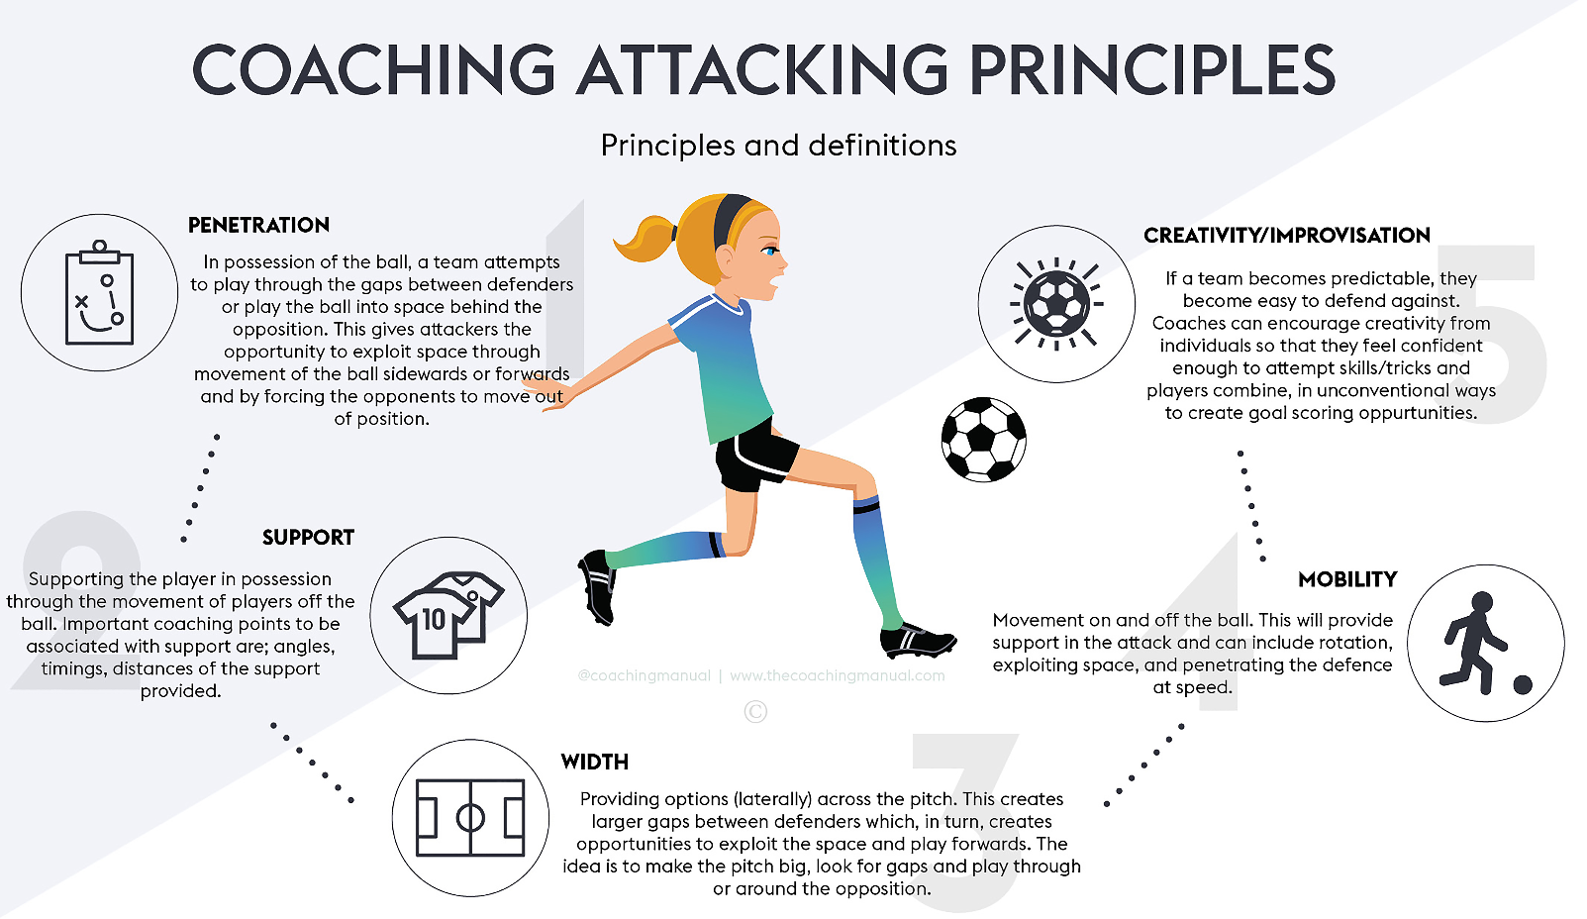
COACHING WORKBOOK

Slide 17
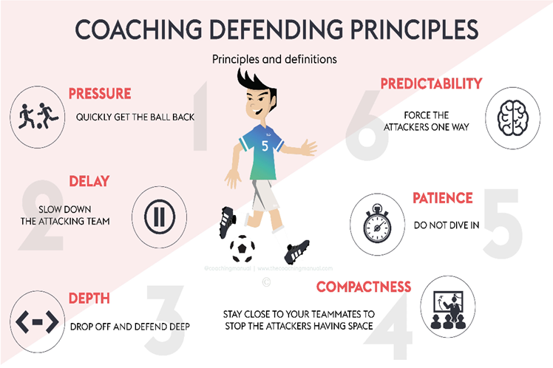
Main Moment BPO

Slide 18
STYLE OF PLAY
COACHING WORKBOOK
4-3-3 DEFENDING TACTICS.

Slide 19
Junior Development Plan
The Coaching Way

Slide 20
Junior Development Plan
We have made massive strides in recent years in the development and provision of our Coach Education pathway and will now look to build on these foundations by providing courses that are more tailor made and client friendly for our coaching workforce. For example, we will endeavour to make our Coach Education courses more age-specific, whereby coaches who work with youth players will attend courses for this specialist age range.
In turn, we will align minimum criteria of coaching qualifications to be attained by team coaches and staff in order to give our young players the best possible opportunity to be.
U6-U9 Licence (Grassroots / Skill Training)
U10-U12 Licence (Grassroots / Skill Training / Youth C Licence)
U13-U16 Licence (Skill Training / Game Training / FFA C Licence)
Director of Coaching ( FFA C Licence / FFA B Licence)
Senior Teams (FFA A / B Licence / Senior C)
The Coaching Way

Slide 21
Junior Development Plan
Junior Coach
Coaches play an important role in the sporting life, but also the everyday life, of the participants they coach. Coaches influence the development of sport-specific skills, and also the participant’s development as a person and their approach to other aspects of their life.
Coaches should:
be a good role model for the participants
show enthusiasm and enjoyment for the task of coaching – make it fun!
be self-confident, assertive, consistent, friendly, fair and competent
ensure the safety of all participants
behave ethically and dress appropriately
maintain discipline throughout the session
be very organised, not only for each session but for the entire season
be able to justify, if necessary, why things are being done, or be ‘big enough’ to ask for suggestions when not sure and to admit and apologise when they make a mistake
treat everyone fairly, and include participants of all abilities and disabilities, ages, genders, and ethnic backgrounds.

Slide 22
Junior Development Plan
Development Over Winning
Club adopts a long-term perspective and is truly focused on individual player development and games are primarily to be used as vehicle for player learning and development, especially during the formative years of the Skill Acquisition & Game Training Phases of development
The main emphasis and focus of games is always individual player development rather than winning the game and this should be the focus and primary objective of the coach
Many young players instinctively strive to win, however it is the responsibility of coaches, parents and everyone involved with the game of football to keep this drive under control and in perspective so that the learning process is not compromised
Sideline instructions by coaches and parents on game day should be minimal so that players are not overloaded with information and are allowed to experiment and find solutions themselves to the all the football problems presented on the football field on game day

Slide 23
Junior Development Plan
Coaching Outcomes:
Improved motivation, confidence, enjoyment and satisfaction.
Increased learning and development.
Enhanced creativity and problem-solving ability.
Better team and individual efforts.
More quality play.
Coaching Workbooks
Mini Roos Workbook U6-U12
JPL Workbook U9-U16

Slide 24
Junior Development Plan
Players Expectations of your Coaching session
Specific - to the topic
Enthusiastic - which will reflect the coaches manner
High tempo - high involvement of players
Planned - session planners should be completed
Reviewed - to ensure continued development
Match realistic - relevant to the way they play
Challenging - players need to be challenged
Achievable - players need to be successful
Enjoyable - players want to play football
Fair - each player requires your attention
Stimulating - creative sessions
Progressive - logical from technical to skill development
Relevant - to the age group you are working with

Slide 25
Junior Development Plan
The Player

Slide 26
Junior Development Plan
The Football player are developed in accordance with the core player development elements of,
Perception (See)
Decision (Think)
Execution (Do)
These 3 core development elements also form the bases for the technical competencies that allow the players to be able to play within the FFA philosophy
Creating Structure by producing players that have the technical characteristics to play a ‘Creative, possession based’ style of football
The playing philosophy of ‘ Creative, possession based ’ football means a style of play that aims to break down opposition defences through a style of football that is free flowing

Slide 27
Junior Development Plan
We must teach our young players to establish in their minds what to do with the ball before they receive it not after (Perception) know before you receive.
Game awareness of what is around you at all times to improve first touch and to encourage accurate and creative decisions (Under pressure-Control-Decision) .
(Execute)(Play) what skill decision will you make base on the (4 core skills)
As coaches we must teach our young players to establish in their minds what to do with the ball BEFORE they receive it not AFTER
At every instant, players must have the ability to look beyond the ball, maintaining an AWARENESS of their team mates and opposing players
The Development of creative possession based football style is the uncompromising belief that this is the FGC way,

Slide 28
THE FGC PLAYER
Junior Development Plan
The Player
Respectful
High level of technical ability
Tactically aware
Professional & Disciplined on and off the park
Always striving to improve
Strong self-belief in your own ability
Good team & Club person
Strong work ethics on and off the park
Every player is a leader (Inspire each other)
Positive outlook with a winning attitude
Positive outlook at defeat (It is a learning lesson in football)
Well presented (self pride)
Loyal – “this is your club for life”

Slide 29
Junior Development Plan
The Future Player

Slide 30
GOALKEEPER
KEY HABITS: In Possession |  | KEY HABITS: Out of Possession
Recognises counter attacking opportunities Makes angles to receive the ball Shows a desire to make decisions and communicate with the team in matches Is confident to adopt a starting position relevant to where the ball is on the pitch Recognises that danger can still occur when we have possession |  | Has a primary instinct to defend his goal Effective shot stopper Can spot dangerous situations around the ball Understands where on the pitch he needs to be in relation to the ball Is beginning to understand his decision making responsibilities Shows a desire to communicate with his team members
TECHNIQUE |  |  | INTELLIGENCE
Defends his ‘ goal’ effectively Is competent at handling the ball or deflecting the ball to safe areas Distributes efficiently from both ground and hand |  |  | Attempts to play quickly when appropriate Is confident in experimenting with different methods of clearing the ball / maintaining possession Has an awareness of dangerous situations within his penalty box Positions himself appropriately in relation to the ball
ATHLETICISM |  |  | PERSONALITY
Practices jumping and diving off both feet Is quick over 6 yards, yet able to set Is able to change direction Shows a desire to make recovery saves |  |  | Responds well to both success and failure Is willing to put his body on the line Enjoys goalkeeping Understands the need to concentrate even when the ball is not near him Is enthusiastic to learn

Slide 31
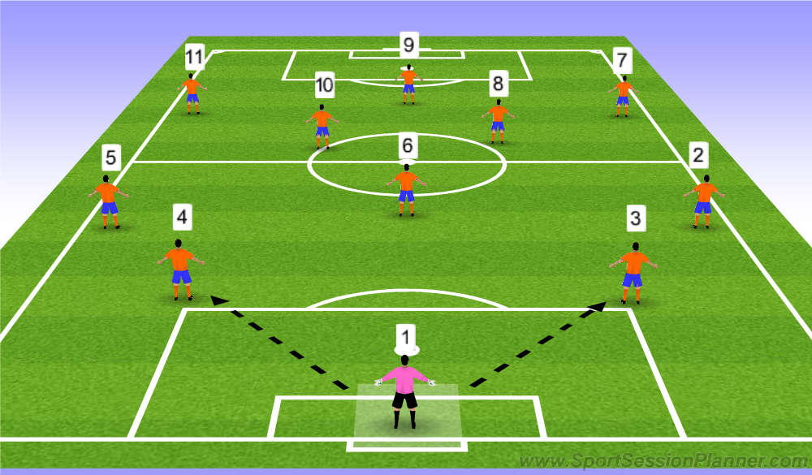
GOALKEEPER
The goalkeeper has an important role in leading and organizing the defence.
In the modern football, the goalkeeper is the last man of defence as well as the start of our build-up play. The goalkeeper’s most important/crucial task is of course figuring out the best position to stand in order to save a shot. It is also important that the goalkeeper is dominant in the penalty area. The goalkeeper has to be aware of the opposition making a through pass behind the defensive line, in this situation the goalkeeper’s job is to act as a sweeper and clear the ball to safety.
Due to the fast paced game nowadays, the goalkeeper must also have the ability to read the game situation and accordingly communicate with the defensive line in order to maximize the strengths at the back.

Slide 32
DEFENDER (3/4)
KEY ROLES & RESPONSABILTIES: In Possession |  | KEY ROLES & RESPONSABILTIES: Out of Possession
Capable of receiving on the back foot on either side and can play off both feet Can effect all three thirds of the pitch when appropriate Can recognise when to penetrate forward or retain possession . Recognises how and when to provide big angles to receive. |  | Is alert to the danger and recognises triggers to win the ball or delay . Is brave & confident when defending in 1v1 situations – will put his body on the line. Defends comfortably in pairs / units recognising when to press or keep shape .
TECHNIQUE | INTELLIGENCE
Can drive out with the ball Has good positive and soft first touch Can play short passes effectively the majority of the time Can compete and win headers . Has simple and effective 1v1 skills . Begins to play effective longer passes Can perform turns whilst still protecting the ball effectively | Can provide big angles to receive including recycle points. Recognises opportunities to make forward runs . Recognises when to challenge or delay Recognises when to press or cover in a defensive pairing. Has good body-shape when defending Can recognise when to play short / longer passes
ATHLETICISM | PERSONALITY
Has good all round ABCs . Able to turn quickly enough to recover in 1v1 situations | Is always alert & aware as well and anticipates danger early Can command and organise both in /out of possession . Strives to be an excellent learner & takes ownership of his development

Slide 33
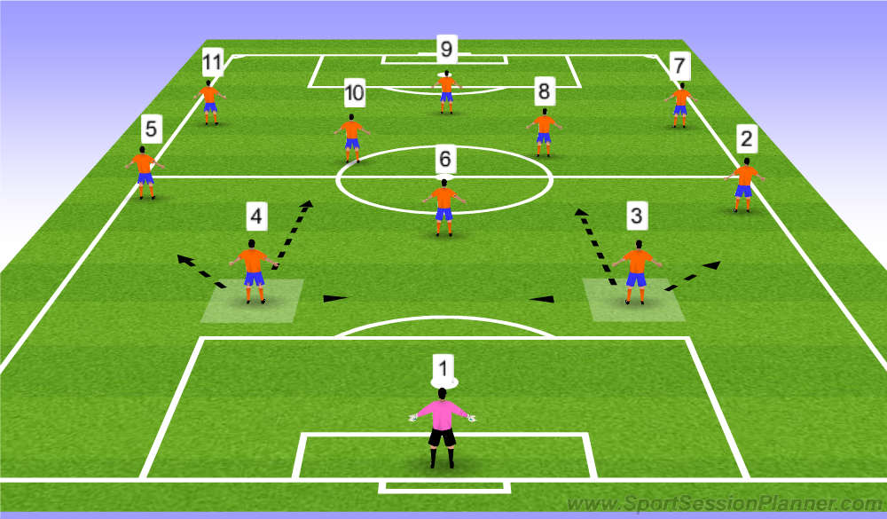
DEFENDER CBs
The main role of the central defender is defend the goal, handle the opposition’s striker(s) and to prevent any threats for goals.
The centre backs have to be in control of the team’s defensive unit as well as marking the opponent’s forwards and to restrict and minimize any shooting chances from the opposition’s offensive player. In terms of defending, the best option for a centre back is to be in a good position to discourage the striker from receiving the ball but if the striker is able to avoid this, the second best option is to intercept the pass given to the striker.
If the striker does have the ball with back to goal the central defender must press to prevent the player from turning.
If the attacking striker is in possession of the ball facing the goal the central defender must restrict the forward to one side of the pitch and wait for an opportunity to make a challenge for the ball.
In terms of offensive responsibilities, the central defenders first role is to be in a good position to receive the ball from the goalkeeper and to ultimately find a pass to teammates.

Slide 34
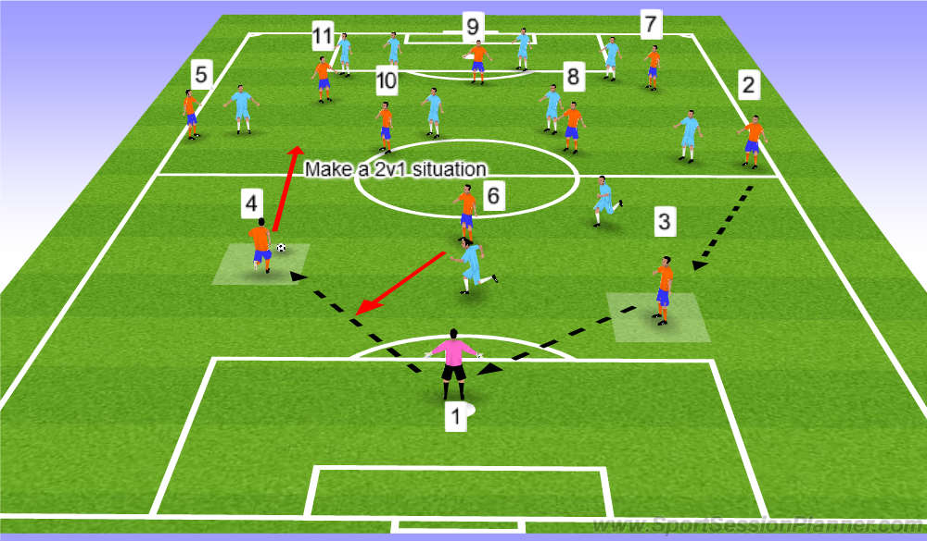
DEFENDER CBs
Another task for the central defender is the importance of switching the play when receiving the ball from one of the full backs. In addition, if one of the central defenders is free when receiving the ball from the goalkeeper, it is also possible for the central defenders to drive with the ball forward into the mid-field area and construct a 2vs 1 situation in the middle to support the offense and act as a (sweeper).

Slide 35
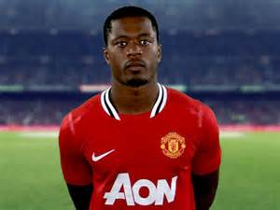
DEFENDER (FB)(2/5)
KEY ROLES & RESPONSABILTIES: In Possession |  | KEY ROLES & RESPONSABILTIES: Out of Possession
Capable of receiving on the back foot on either side and can play off both feet Can effect all three thirds of the pitch when appropriate Can recognise when to penetrate forward or retain possession . Recognises how and when to provide angles to receive. Makes good decisions on when to dribble or pass. Has an end product (crosses / goals) Has effective 1v1 skills and displays confidence to use them |  | Is alert to the danger and recognises triggers to win the ball or delay . Is brave & confident when defending in 1v1 situations – will put his body on the line. Defends comfortably in pairs / units recognising when to press or keep shape .
TECHNIQUE | INTELLIGENCE
Can drive out with the ball Has good positive and soft first touch Technically good in the air and ground Can play short passes effectively the majority of the time Can compete and win headers . Has simple and effective 1v1 skills . Begins to play effective short or longer passes Can perform turns whilst still protecting the ball effectively | Can provide big angles to receive including recycle points. Recognises opportunities to make forward runs . Recognises when to challenge or delay Recognises when to press or cover in a defensive pairing. Has good body-shape when defending Can recognise when to play short / longer passes
ATHLETICISM | PERSONALITY
Has good all round ABCs . Able to turn quickly enough to recover in 1v1 situations Is quick and/or explosive over short / medium distances | Is always alert & aware as well and anticipates danger early Can command and organise both in /out of possession . Strives to be an excellent learner & takes ownership of his development

Slide 36
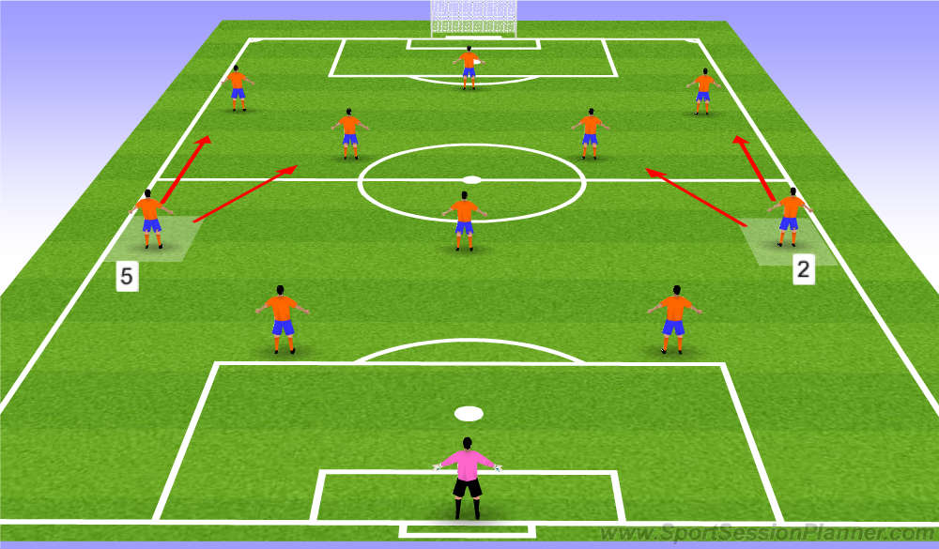
DEFENDER (FB)(2/5)
In modern football the full back position has a dynamic role, acting as a defender and as an attacker, usually overlapping down the line like a winger. Full backs has become a very important position in the modern football.
Full backs in the modern game have a very demanding role and therefore the physical requirement of a modern day full back must take this into consideration these physical characteristics; speed, power/explosiveness speed endurance are required as full backs have to cover large playing area usually dominating the side lines.
In term of technical requirements, full backs must have good fundamental foot work or skill in order to feed good balls to start an offensive combination play. Full backs first offensive option is to feed the ball to either players No.7 or No.11, the second best option is to pass with good weight, into either players No.9/No.10. If there is no way forward the full backs must retain possession and this may result in playing the ball back to the centre back or goalkeeper.

Slide 37
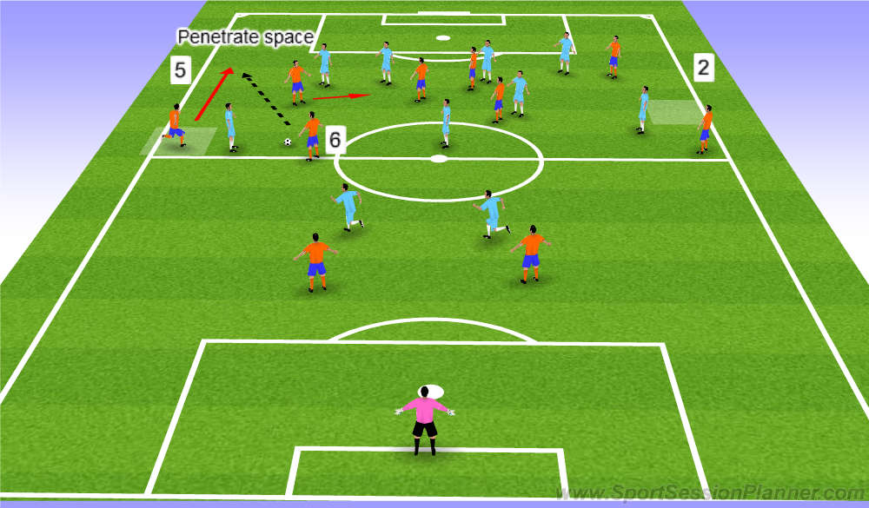
DEFENDER (FB)(2/5)
Overlapping movement from full back
Full backs need to have good crossing ability in case of an overlapping situation started from the offensive winger feeding into the outer side of the area. Nowadays, full backs also cut inside as well, combining with the forward to create greater chances in the top third. The full back must also be confident and strong when faced in a 1vs1 situation as they must have the ability to dribble and give danger to the defender in order to create greater crossing chances.

Slide 38
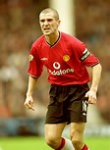
MIDFIELDER (6)
KEY HABITS: In Possession |  | KEY HABITS: Out of Possession
Capable of receiving on the back foot on either side and can play off both feet Has good 360’ awareness. (Master your Circle ) Recognises space and makes good decisions on when to dribble or pass (begins to dictate the play) Positively effects all thirds of the pitch (adds goals & assists) |  | Recognises triggers to win the ball or delay . Works effectively in units & pairs to screen his defenders or make play predictable Anticipates danger early and is quick on transition to either press or regains shape
TECHNIQUE | INTELLIGENCE
Can drive forward with the ball Has good positive and soft first touch Can play short passes effectively ( be creative ) Can receive the ball effectively on the half-turn Has simple and effective 1v1 skills in tight areas Can play quick combinations Begins to develop a range of passing | Is brave in possession and recognises opportunities to make forward runs. Can become the pivot player to support play all over the pitch Often knows his next pass Gets head up early recognising when to play with minimal touches . Looks to find pockets of space to receive
ATHLETICISM | PERSONALITY
Has good all round ABCs . Can consistently get from box to box | Strives to be an excellent learner & takes ownership of his development Brave in the tackle (IRISH) Shows imagination and creativity in possession

Slide 39
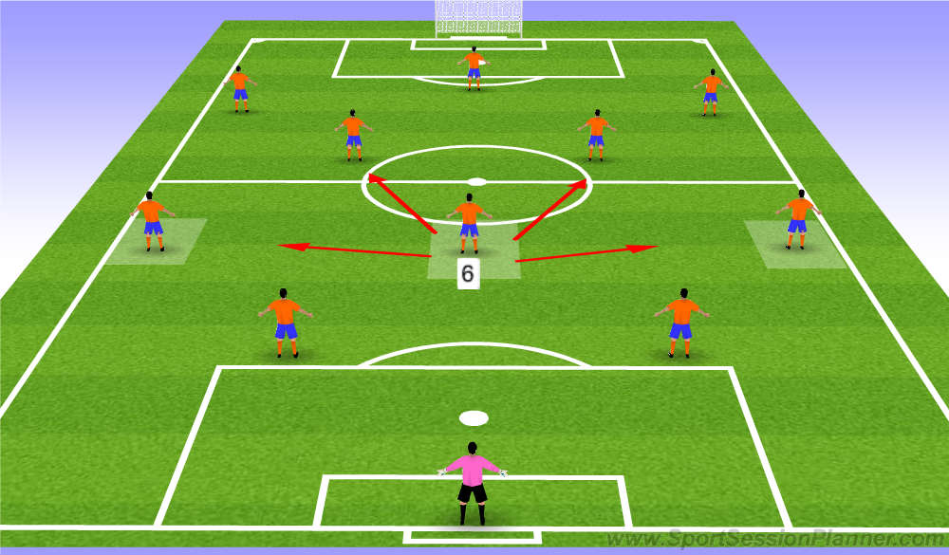
MIDFIELDER (6)
The defensive midfielder is one of the most essential roles in the modern day football and is considered the back bone of both the offensive and defensive part of the game.
In terms of offensive tasks, the defensive midfielders are acting as the link between the backline players and the attacking midfielders and forwards.
Offensively, the player’s first objective is to feed the ball and deliver accurate passes to his teammates. The second best option is to use long passes to both flank attackers. He is also a key man in conducting a switch of play therefore he must also be confident in the ability to switch the play by either sending long aerial balls to either side of the wingers or directly to the striker.
In terms of defensive duties, he may act as a sweeper in front of the backline to clear all balls and to mark any opponent who comes into the crucial area.

Slide 40
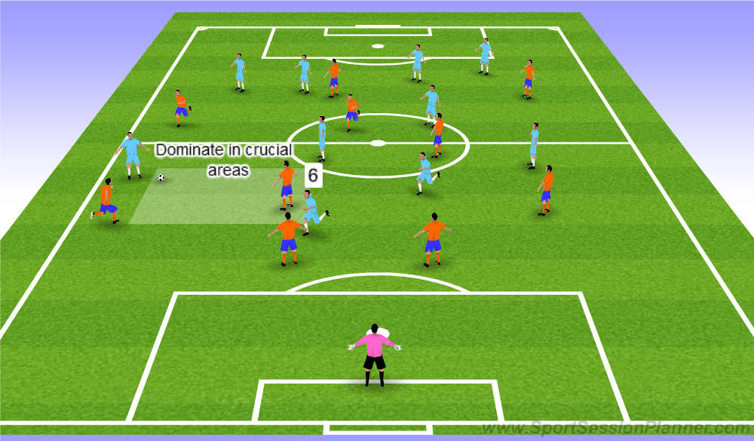
MIDFIELDER (6)
Covering crucial area
In terms of defensive duties, he may act as a sweeper (Screen) in front of the backline to clear all balls and to mark any opponent who comes into the crucial area.

Slide 41
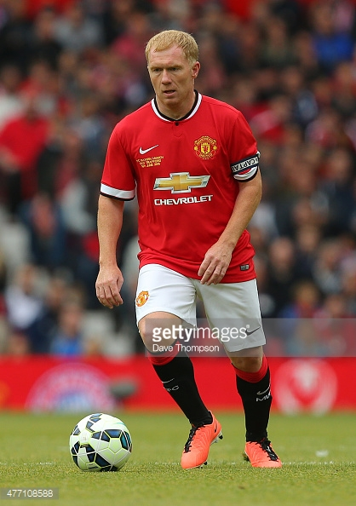
MIDFIELDER (8/10)
KEY HABITS: In Possession |  | KEY HABITS: Out of Possession
Capable of receiving on the back foot on either side and can play off both feet Has good 360’ awareness. (Master your Circle ) Recognises space and makes good decisions on when to dribble or pass (begins to dictate the play) Positively effects all thirds of the pitch (adds goals & assists) Makes good decisions on when to dribble or pass. |  | Recognises triggers to win the ball or delay . Works effectively in units & pairs to screen his defenders or make play predictable Anticipates danger early and is quick on transition to either press or regains shape
TECHNIQUE | INTELLIGENCE
Can drive forward with the ball Has good positive and soft first touch Can play short passes effectively ( be creative ) Can receive the ball effectively on the half-turn Has simple and effective 1v1 skills in tight areas Can play quick combinations Begins to develop a range of passing | Is brave in possession and recognises opportunities to make forward runs. Can become the link player to support attacking play Often knows his next pass Gets head up early recognising when to play with minimal touches . Looks to find pockets of space to receive
ATHLETICISM | PERSONALITY
Has good all round ABCs . Can consistently get from box to box Is quick and/or explosive over short / medium distances | Strives to be an excellent learner & takes ownership of his development Brave in the tackle Shows imagination and creativity in possession

Slide 42
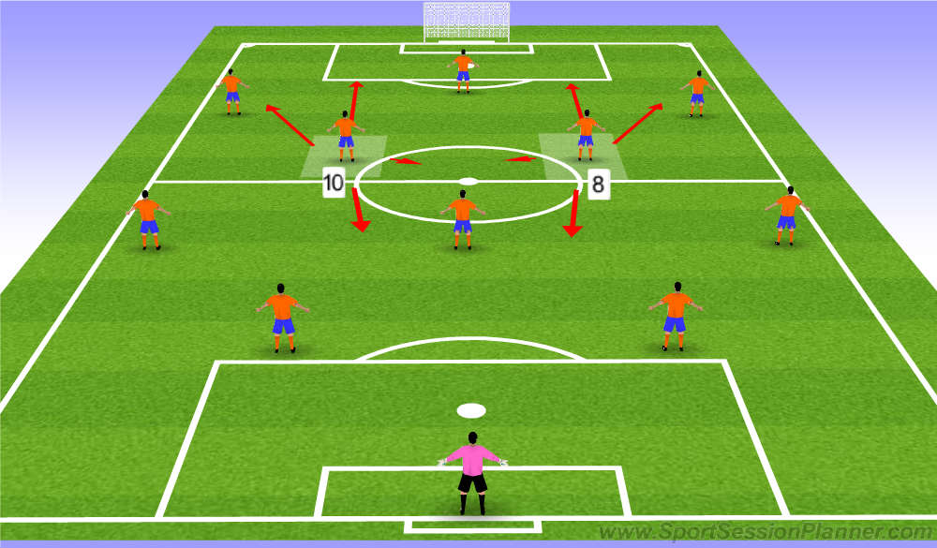
MIDFIELDER (8/10)
Offensive mid-fielders are often considered to be the most demanding position in the game of football.
In the football curriculum, the two mid-fielders No.8 and No.10 tend to have slightly different offensive duties. Firstly No.8 midfielder tends to play further back compared to the No.10 midfielder who is expected to touch, turn with the ball most of the time.
No.8’s main job is also involved in feeding the ball into the striker N0.9 or to either wingers No.7/No.11 when received from either the defensive midfielder (No.6) or from the full backs (No.2/No.5), implementing more of a pass game.
No.10 has more of a penetrating role offensively. No.10 midfielders tend to have a strong dribbling ability, dealing easily and confidently with 1vs1 situations also having good powerful shooting ability. No.10’s role is also to always receive the ball in the opposition’s “crucial area” and by combing play with No.9 or either wingers No.7/No.11 the No. 10 midfielder has an advantage in penetrating the last line of the opposition’s defence line and into the opposition’s penalty box.

Slide 43
MIDFIELDER (8/10)
Defensively both midfielders No.8 and No.10 have identical defensive roles. In terms of defence, when the opposition’s has the ball up front; one of the first things both midfielders No.8/No.10 have to do is to give pressure up top to both opposing midfielders. If the ball possession is with the opposition’s full backs No.2/No.5, both midfielders have to take up a role to cover and help support the wingers No.7/No.11 in defence. But if the opposition’s winger No.7/No.11 manages to keep possession of the ball, the midfielder’s job is now to go back and to close down the 4 defenders and keep a very compact defensive formation in order to reduce the opposition’s chances of entering the “crucial area”.
In a defensive third crossing situation, both offensive midfielders must position themselves in front of the central defender in order to prevent any “cut back” plays made by the opposition.

Slide 44
WIDE ATTACKERS (7/11)
KEY HABITS: In Possession |  | KEY HABITS: Out of Possession
Recognises how to create space to receive the ball in good areas Makes good decisions on when to dribble or pass. Has an end product (crosses / goals) Has effective 1v1 skills and displays confidence to use them |  | Is alert to the danger and recognises triggers to win the ball / Delay . Can react quickly to regain shape with quick recovery runs or tracking runners
TECHNIQUE | INTELLIGENCE
Can play quick combinations in tight areas Has good positive and soft first touch Can play short passes effectively Different weight of passes to retain possession (sets etc.) Always scanning to know what's next. Shows good body shape to receive | Can provide big angles to receive Can begin creating space for others with different runs Comfortable in both 1v1 situations ( attack / Defend ) Reacts quickly to transitions Freedom of movement to receive
ATHLETICISM | PERSONALITY
Has good all round ABCs . Can consistently get from box to box Is quick and/or explosive over short / medium distances | Strives to be an excellent learner & takes ownership of his development Is Always Alert , Aware , Anticipation Shows imagination and creativity in possession Willing to defend & be brave

Slide 45
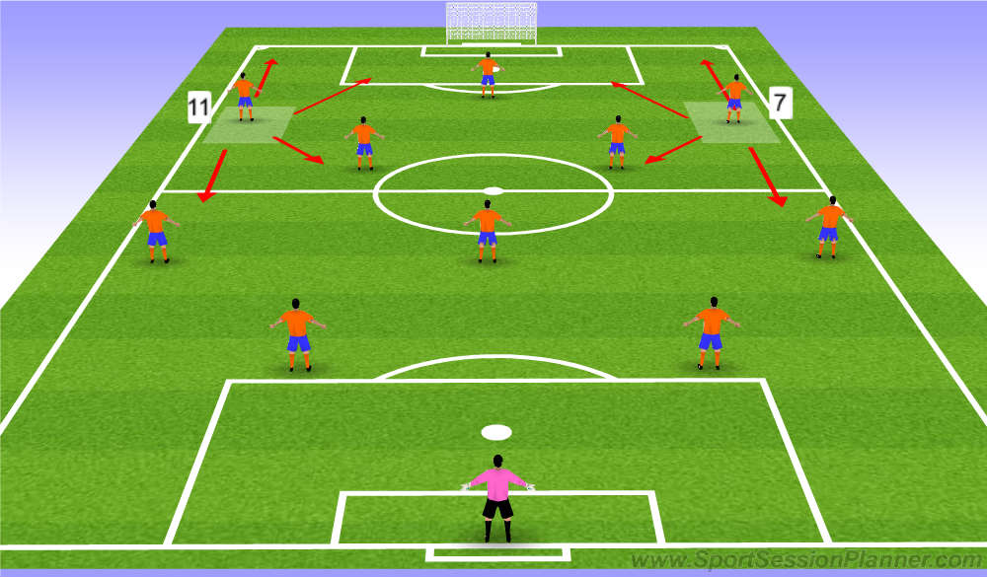
WIDE ATTACKERS (7/11)
We use wide attackers in a wide and deep starting position. This usually stretches the opponent’s defenders and gives more space within the middle of the pitch, allowing offensive midfield players to have more time on the ball and also to allow them to control the game.
The basic role of the wide attacker is to attack the side lines in order to breakdown the opposition’s back four and successfully execute a cross into the opponents penalty box. But nowadays, the wide attacker’s job is not only restricted on the side lines, but also to act as an offensive forward by cutting inside the opponents “crucial area” and creating a quick combination play with the striker No.9 or with either midfield players (No.8/10), finishing off with a shot or with a cross.
This movement also causes the side lines to be open and full backs No.2/No.5 now can take up the role of a winger, flanking the side and successfully crossing the ball into the opponent’s penalty box.

Slide 46
WIDE ATTACKERS (7/11)
As well as accurate crossing ability, wide attackers are also required to possess good dribbling and running skills, as most wide attackers often face 1vs1 situations on the side against the opponent’s defenders penetrating the space behind. When the ball is in the opposite side of the field, wide attackers must have good determination and spatial awareness in order for them to cut inside and to get into a good goal scoring position. In case of team plays with a deep lying striker system, then both flank attackers will act as a striker.
In terms of defensive responsibility, flank attackers have a crucial role to play. Firstly flank attackers need to be able to put pressure on the opposition’s central defenders (No.3/No.4) and the fullbacks (No.2/No.5) when the opponents are in possession. This means channelling and forcing the opposition’s play to one side of the field, increasing the chance of recovering the ball at the backline of the opponent half and may result goal scoring opportunity.

Slide 47
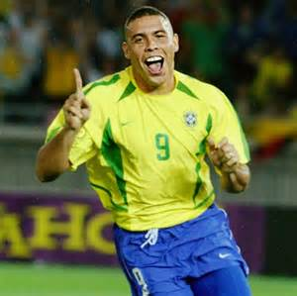
STRIKER (9)
KEY HABITS: In Possession |  | KEY HABITS: Out of Possession
Recognises how to create space & make penetrative runs Is brave & instinctive in the box Has good composure with a variety of finishes in front of goal . Recognises when and how to protect the ball and how to bring in others into play |  | Reacts quickly to transitions in order to regain shape, screen forward passes or to win possession Is always on the front foot & willing when pressing high up the pitch. Unsettles the oppositions defenders when on the ball
TECHNIQUE | INTELLIGENCE
Has effective 1v1 skills and displays confidence to use them Has good positive and soft first touch in tight areas Can play quick combinations Recognises when to play 1, 2 or more touches Has a range of finishing techniques | Begins to recognise opposition weaknesses Can provide a target to play to when in possession Can make play predictable. Can begin creating space for others with different runs
ATHLETICISM | PERSONALITY
Has good all round ABCs . Powerful & explosive over short / medium distances | Strives to be an excellent learner & takes ownership of his development Hard-working & brave to chase and effect ‘lost causes’ Is Always Alert , Aware , Anticipating (no ball watching) Shows imagination and creativity in possession Responds well to success and Failure.

Slide 48
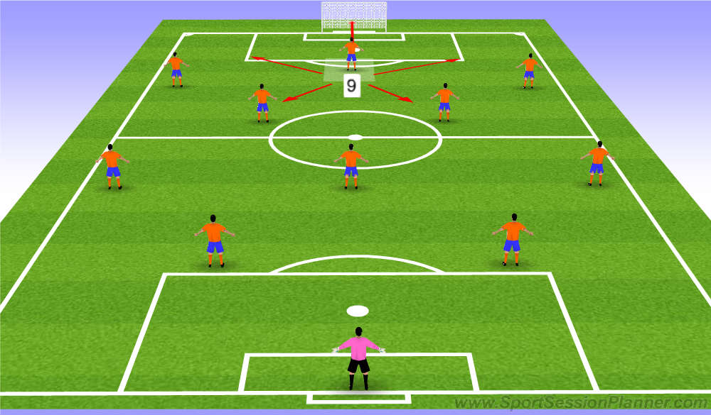
STRIKER (9)
A typical striker (No.9) must possess excellent technical skills to control the ball in tight spaces to aim for goals.
Striker must be able to receive, link passes and win most of the challenges when faced against strong opposition’s central defenders (No.3/No.4) and of course, having the ability to score goals.
Defensively, a centre forward’s role is to be the first player to start the high pressure on the opponent’s central defenders or midfielders (TRIGGER), channelling the opponents to one side of the field allowing the offensive players to intercept or steal from the opposition.

Slide 49
Junior Development Plan
The Development Blocks

Slide 50
Junior Development Plan
PLAYER DEVELOPMENT BLOCKS
The JDP operates a building block approach to player development. Players follow an initial path heavily focused on technique and skill development, and as competency increases tactical elements are introduced. Within each building block an extensive curriculum is designed to focus on the necessary skill set.
As a player progresses through the system they will continue to work on elements of preceding stages to ensure they are consistently and simultaneously challenged on both fundamental and advanced levels. The following diagram illustrates the Football Way approach.

Slide 51
FFA Building Blocks
Junior Development Plan
The END

Slide 52
Junior Development Plan
BECOMING A PROFESSIONAL
& LEARNING TO WIN
BUILDING A CAREER
PATHWAY & LEARNING TO COMPETE
TRANSITION INTO SENIOR SQUAD
Preparing players for the 1st Team environment
Physical development to cope with 1st team demands
Refining technical & tactical skills
Mastering position specific requirements
Learning how the 1st team plays (style & shape)
Learning how to win & game management
PERFORMANC E LEVEL
LEARNING TO LOVE GAME
PRACTICE & PLAY
POSITION SPECIFIC DEVELOPMENT
Developing technical & tactical positional expertise
Learning to play the ‘real’ game & different systems
Managing peak growth & maturation
Learning to be competitive
Developing a growth mind-set & taking increased ownership
LEARNING TO LOVE ORGANISED FOOTBALL
FUNDAMENTALS & TECHNICAL DEVELOPMENT
Develop a solid base of technical skills
Competing in a team/social dynamic
Progress towards a position specific profile by U13s
Developing good habits on & off pitch
BASIC HABIT DEVELOPMENT
Learning to play in a team & organised football
Developing basic core habits as a foundation
Play for enjoyment
Develop a love for the game
AGE
DISCOVERY
SAP
GAME TRAINING
PERFORMANCE PHASE
U6s - U8s
U9s - U12s
U13s – U16s
U18s - Seniors

Slide 53
Junior Development Plan U6/7
BASIC HABIT DEVELOPMENT U6/7:
LOVES THE GAME
Listens & responds to information
Coachable
TECHNIQUE | PERSONALITY
Loves to have the ball 4 Core Skills | Responds well to team mates and coaches. Has a love for the game & wants to play more Developing skills to become a good learner
ATHLETICISM | INTELLIGENCE
ABCs | Can make good decisions on when to pass / dribble / shoot

Slide 54
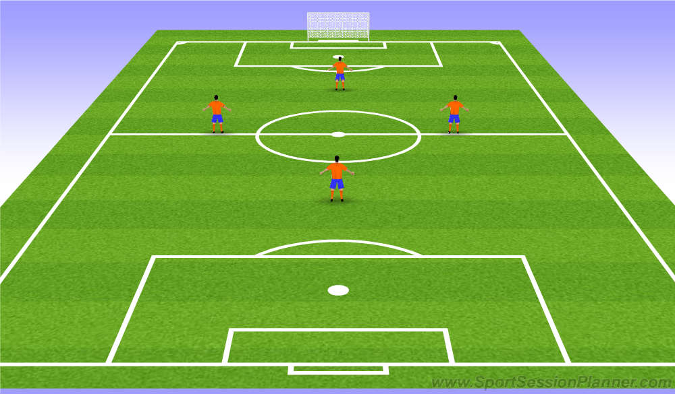
Junior Development Plan
Primary Games Format: 4 a-side (2 x 15 minutes)
Primary Formation: Diamond 1 – 2 – 1
Ideal Match-day Squad Size: 6 players
Game Types: Friendlies (Single Matches or Round-Robins). Summer Tournament Football.
Coaching tips:
No ‘coaching’ only stimulating and praising ‘Natural’ development through just playing and discovering one’s (im)possibilities through trial & error.
Emphasis on fun and building a love of the game.
The best coach is not the one who shouts instructions the whole game, however unfortunately many parents seem to feel that’s what good coaches are supposed to do.
• In 4 v 4 football, the
‘coach’ should not worry about ‘tactics’ other than encouraging the kids to try and score when they have the ball and win it back when the other team has the ball in order to prevent them from scoring
• Aim for equal playing time.

Slide 55
OUTFIELD PLAYERS U8/9
KEY HABITS: In Possession |  | KEY HABITS: Out of Possession
Capable of receiving of the back foot on either side Head up on the ball to promote good decision making 1st touch to take the ball into space (Master your Circle) Is comfortable & confident in all 1v1 situation (specific 1v1s) |  | Is alert to the danger and recognises when to win the ball or delay . Is brave & confident when defending in 1v1 situations –
TECHNIQUE | PERSONALITY
Able to dribble or run with the ball Has a positive and soft first touch Has more than one 1v1 / skills / tricks | Brave both in and out of possession (to receive and in the tackle) Responds well to mistakes. Displays good social & communication skills Has a love for the game & wants to play more
ATHLETICISM | INTELLIGENCE
Is fast enough to compete effectively in their own games ABCs | Can make good decisions on when to pass / dribble / shoot Shows imagination and creativity in possession

Slide 56
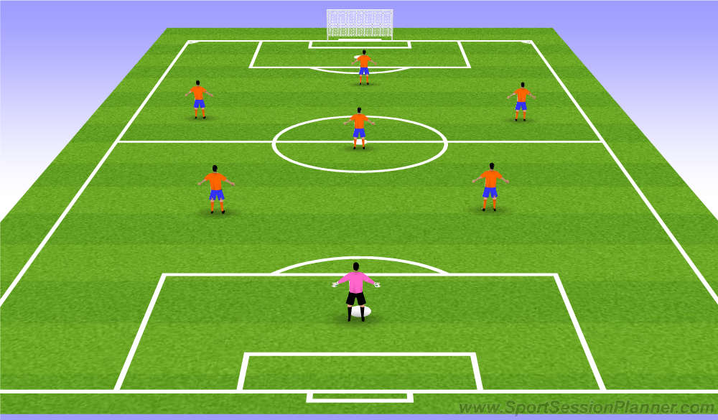
U8/9 PLAYING SYSTEMS
Junior Development Plan
In 7 v 7 football, The focus in training is on the individual player, so in the weekend game the players should have the opportunity to apply their skills in a game setting. The coach organises the players into two lines of three with a Goalkeeper behind. The players just need simple tasks so they do not become confused or overwhelmed with information
(Examples: ‘You three try to defend more than you attack’ ‘you three try to attack more than you defend’ ‘let’s see if we can always have one of our players pushed right up in the middle of the pitch’ ‘when the opponent has the ball, can we get one of our team near every one of their players on the goal side’, etc)
At half-time, the coach should rotate players around to experience different aspects of the game (e.g. the three defenders become the three attackers)
Aim for equal playing time

Slide 57
OUTFIELD PLAYERS U10/12
KEY HABITS: In Possession |  | KEY HABITS: Out of Possession
Capable of receiving of the back foot on either side Head up on the ball to promote good decision making 1st touch to take the ball into space (Master your Circle) Is comfortable & confident in all 1v1 situation (specific 1v1s) |  | Is alert to the danger and recognises triggers to win the ball or delay . Is brave & confident when defending in 1v1 situations – will put his body on the line.
TECHNIQUE | PERSONALITY
Able to dribble or run with the ball effectively Has a positive and soft first touch Has more than one 1v1 strategies / skills / tricks Different weight of passes to retain possession (sets etc.) Recognises when to play 1, 2 or more touches Protecting the ball (shield and bring others in) Frequently scans to assess the situation | Brave both in and out of possession (to receive and in the tackle) Is Alert , Aware Responds well to success and Failure. Displays good social & communication skills Has a love for the game & wants to play more
ATHLETICISM | INTELLIGENCE
Is fast enough to compete effectively in their own games ABCs | Can make good decisions on when to pass / dribble Gets head up early recognising when to play minimal touches . Shows imagination and creativity in possession

Slide 58
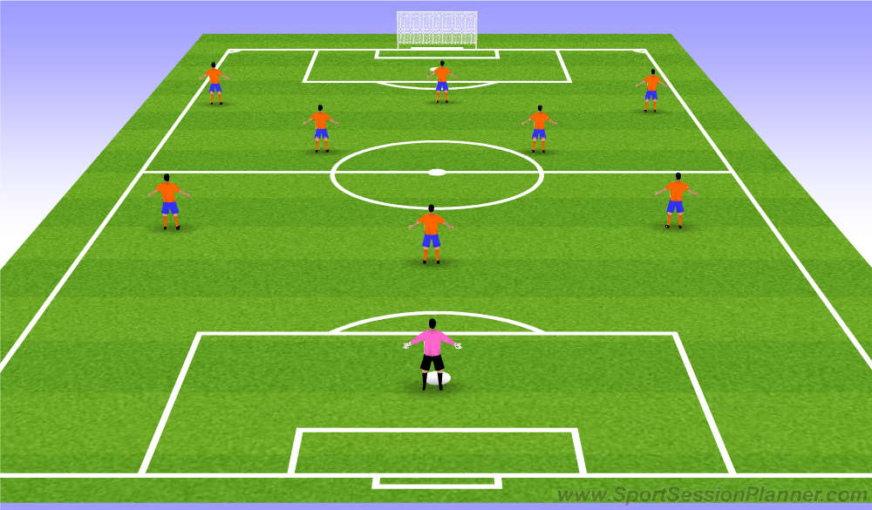
U10/12 SYSTEMS
STRATEGY: To build a platform at 9 aside that is close to replicating a 4-3-3 formation used at 11aside at under 12s introduce players to a 4-3-3 shape still with the main emphasis being on technical aspects as well as adding more tactical detail .
REASON: To allow for freedom of movement to be expressed throughout players will continually rotate
throughout this shape.
SYSTEMS: Under 10/12s : 1 - 3 - 2 – 3 / 3-3-2
9 aside Teams will play with three centre backs who will begin to command and work in units – in possession 1 x CB is released to become a full-back and support play. Two centre midfielders will work box-to-box and effect all 3 thirds. Both wide midfielders will provide width with coaches encouraging 1v1s but will also track runners and cover CB’s in the wide channel. The striker will lead the line and create targets to help bring others into play.

Slide 59
SAP PHASE – U10/12s
Junior Development Plan
9v9 GAME
Even though football is a simple game to play, it is an extremely difficult game to master. The open-ended nature of the game means that participants must be equipped with the ability to process information, make decisions and execute them in multiple directions under varying amounts and types of pressure and stimulus.
Therefore, a jump from 7v7 directly to 11v11 can be too much for some players, especially when they are still refining their technical skills and learning to make sense of the game.
Therefore, the 9v9 format can address these issues by allowing the children to play on a pitch (80x50) roughly two thirds the size of an adult pitch whilst only adding 2 players per side to the 7v7 format they have progressed from.

Slide 60
OUTFIELD PLAYERS U13/16
KEY HABITS: In Possession |  | KEY HABITS: Out of Possession
Capable of receiving of the back foot on either side Head up on the ball to promote good decision making 1st touch to take the ball into space (Master your Circle) Is comfortable & confident in all 1v1 situation (specific 1v1s) |  | Is alert to the danger and recognises triggers to win the ball or delay . Is brave & confident when defending in 1v1 situations – will put his body on the line. Defends comfortably in pairs / units recognising when to press or keep shape
TECHNIQUE | PERSONALITY
Able to dribble or run with the ball effectively Has a positive and soft first touch Has more than one 1v1 strategies / skills / tricks Different weight of passes to retain possession (sets etc.) Recognises when to play 1, 2 or more touches Protecting the ball (shield and bring others in) Frequently scans to assess the situation | Brave both in and out of possession (to receive and in the tackle) Is always Alert , Aware Responds well to success and Failure. Displays good social & communication skills Has a love for the game & wants to play more Strives to be an excellent learner & takes ownership of his development
ATHLETICISM | INTELLIGENCE
Has good all round ABCs . Able to turn quickly enough to recover in 1v1 situations Is quick and/or explosive over short / medium distances | Can make good decisions on when to pass / dribble Gets head up early recognising when to play minimal touches . Recognises space in which to receive and create angles Shows imagination and creativity in possession

Slide 61
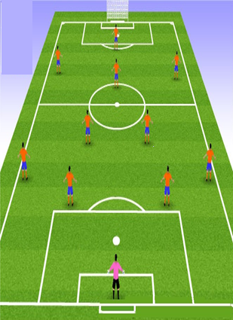
U13/16 SYSTEMS
STRATEGY: introduce players to a 4-3-3 shape still with the main emphasis being on technical aspects as well as adding more tactical detail .
REASON: To allow for freedom of movement to be expressed throughout players will continually rotate
throughout this shape.
SYSTEMS: Under 12-16 : 1-4-3-3
11 aside Players will learn how to work in larger units. A traditional back four will provide a solid defensive line with full backs learning when & where to create overloads when in possession. Out of possession defenders will quickly compact the pitch and learn principles of press, cover, support & balance. Two CB’s will how to become effective recycle points. Two CM’s will screen defenders out of possession, maintain compact distances (Press & cover) & track runners. In possession they will aim to dictate the play with lots of rotation and good decision making on when to play forward or when to recycle. The AM (can rotate with CM) will provide lots of creativity and invention by playing in pockets are breaking the defensive line with forward runs. Wide midfielders will provide width to stretch defenders and provide attacking threat from the wide channel (crosses etc) or coming inside to combine with the AM or ST – they will also support their FB in defensive duties. The ST will lead the line and provide targets to play off of. This will include holding the ball up and running in behind. He will aim to be the biggest goal scoring threat by playing within the width of the 6 yard box in the final third. All attacking players are responsible for pressing from the front as a 3 or 4.

Slide 62
Performance phase
PERFORMANCE PHASE (U18+)
At this age players and their parents will be making decisions about the player’s future direction and whether to continue to challenge to be a professional player or to focus on education.
During this phase the players learn about the tactical side of the game and how to win.
By this age the players will have learnt the basic technical elements of football and now the players need to develop physically and mental strength.
Training sessions should include high intensity activity so that players learn how to play under pressure.
It is important during this phase that players develop a winning mentality and learn to remain positive and confident even if they make a mistake.

Slide 63
Performance phase
PERFORMANCE PHASE (U18+)
CHARACTERISTICS:
Introduce more tactics, formations and game planning.
Develop a players physical condition such as strength, endurance and speed; not forgetting flexibility.
Training sessions must include decision making so that a player gains knowledge and experience that will develop the player in a competitive game environment.
COACHING PHILOSOPHY
During this phase the training sessions are similar to a professional senior level including high intensity training and tactical preparation for the game.
Establish clear objectives and a session plan before the training starts and brief the players and give clear instructions.
Provide good warming up to prevent injury.
Complete the sessions with a good warm down and include a session debrief as the end.

Slide 64
Junior Development Plan
Playing Formation and Structure

Slide 65
1.4.3.3 Numbering System
Junior Development Plan
Notes:
The game is the best teacher of the game, KNVB approach

Slide 66
1.4.3.3 Numbering System
Junior Development Plan
Notes:
The game is the best teacher of the game, KNVB approach

Slide 67
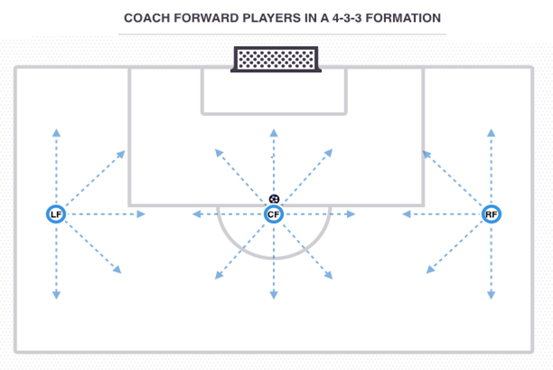
Coaching attackers in a 4-3-3
Structure
The Forward unit in the 4-3-3 is made up of a Left Forward/Winger, Right Forward/Winger and a Centre Forward. The roles and requirements of your front 3 are dependent on the player profiles within your team.
Your attacking unit may be given freedom to rotate and interchange positions with Forwards dropping deep to confuse markers or moving from central positions to wide positions, and vice versa, to create and exploit space. This concept of rotation is to create and exploit space.
Alternatively, your team may possess 2 x wide players capable of delivering the ball to create goal scoring chances, and a prolific goalscorer who can occupy opposition Central Defenders and bring team mates into play. Therefore, the Forward players would have clear roles and areas of the pitch to operate in to play to their strengths.

Slide 68
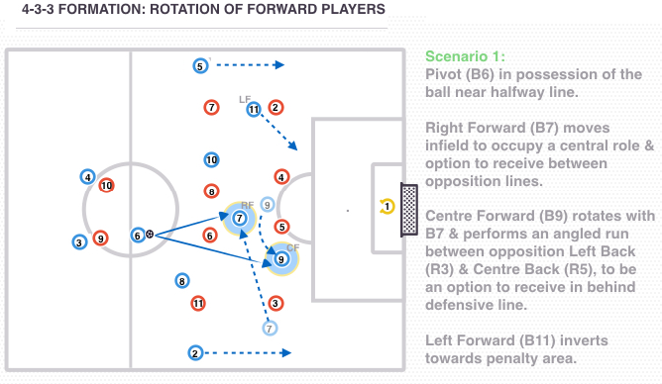
Coaching attackers in a 4-3-3
In Possession
Rotation of Forward players
Tactical flexibility and rotation of Forward players can be a key concept in the 4-3-3 formation, to utilise space in the final third.
Scenario One:
In the above scenario, the Pivot (Blue 6) is in possession as the Right Forward (Blue 7) moves infield to offer a passing option between the lines and unbalance the opposition defence.
This also allows the Centre Forward (Blue 9) to rotate positions with the Right Forward (Blue 7) and perform an angled run in behind the opposition defence to receive.
The movement of the Blue 7 will also create space on the right side of the pitch for the Right Back (Blue 2) to advance, as the opposition Left Back (Red 3) tucks inside. Movement from 11 will allow space for Full Back (Blue 5)

Slide 69
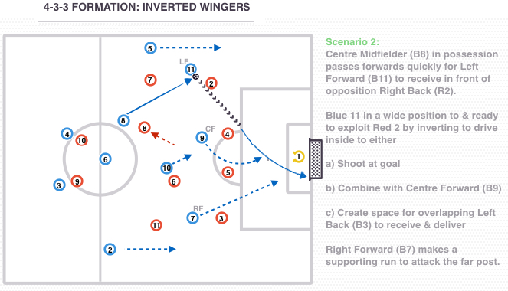
Coaching attackers in a 4-3-3
Inverted Wingers
Many teams adopting the 4-3-3 formation utilise 'Inverted Wingers', with the Wide Forwards driving inside to support the attack in central areas whilst creating space for the advancing Full Backs to offer width.
Scenario Two:
The Left Forward (Blue 11) receives the ball and looks to drive inside, between the opposition Right Back (Red 2) and Centre Back (Red 4). This provides space for the overlapping Left Back (Blue 5) to create further problems for the opposition Full Back (Red 2).
By inverting, the Left Forward (Blue 11) has options to either shoot at goal, combine with the Centre Forward (Blue 9) or play to the overlapping Left Back (Blue 5) to cross from the wide area. Right Forward (Blue 7) also supports the attack by driving inside and attacking the far post creating space for Right Back (Blue 2 ) to push high.

Slide 70
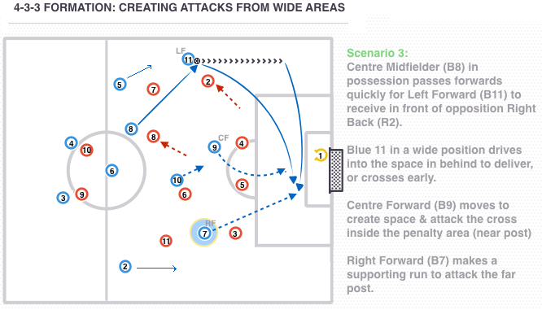
Coaching attackers in a 4-3-3
Creating attacks from wide areas
Scenario Three:
Wide Forwards (Blue 11 and Blue 7) may also look to offer width to the team in attack, with Blue 11 receiving the ball in a wide position and attacking the Right Back (Red 2) to deliver from the wide area, or deliver early if on to do so.
If the ball is with the Left Forward (Blue 11) in a wide position, the Right Forward on the opposite side should move inside to become the 2nd Centre Forward and support the attack. Blue 9 will stay centrally to occupy the Centre Backs (Red 4 & 5) and attack the ball in the box.

Slide 71
Coaching attackers in a 4-3-3
Creating attacks from wide areas
Scenario Three:
Wide Forwards (Blue 11 and Blue 7) may also look to offer width to the team in attack, with Blue 11 receiving the ball in a wide position and attacking the Right Back (Red 2) to deliver from the wide area, or deliver early if on to do so.
If the ball is with the Left Forward (Blue 11) in a wide position, the Right Forward on the opposite side should move inside to become the 2nd Centre Forward and support the attack. Blue 9 will stay centrally to occupy the Centre Backs (Red 4 & 5) and attack the ball in the box.

Slide 72
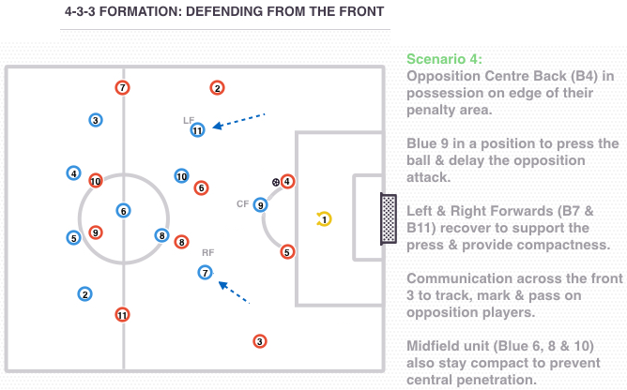
Coaching attackers in a 4-3-3
Creating attacks from wide areas
Out of Possession
Defending from the front
When possession is lost, the front 3 still have defensive responsibilities and should aim to win the ball as quickly and as high up the pitch as possible.
Scenario Four:
In the above scenario, the opposition have possession on the edge of the penalty area with Red 4. Centre Forward (Blue 9) is in a position to press and affect the player on the ball, as the Wide Forwards (Blue 7 and Blue 11) recover to support the press and provide compactness.

Slide 73
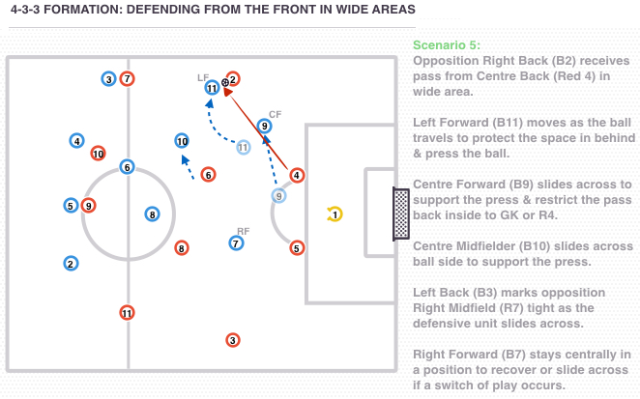
Coaching attackers in a 4-3-3
Scenario Five:
As the ball is played wide to the opposition Right Back (Red 2), Blue 11 moves as the ball travels to protect the space in behind and press the ball.
Centre Forward (Blue 9) also slides across to prevent the pass back to the opposition Goalkeeper or Centre Back (Red 4), whilst the Right Forward (Blue 7) stays centrally in a position to recover or press the ball if switched to the weak side.

Slide 74
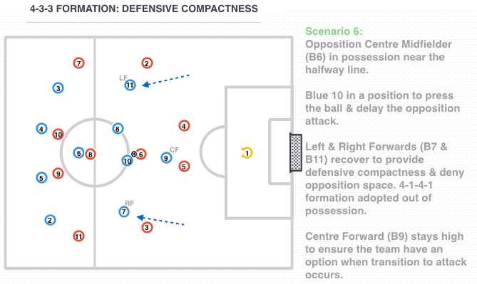
Coaching attackers in a 4-3-3
Scenario Six:
Defensive compactness
If possession is secured by the opposition, the Forward players recover to provide defensive compactness and deny the opposition space.
With opposition Central Midfielder (Red 6) in possession, Wide Forwards (Blue 7 and 11) recover into the midfield line creating a 4-1-4-1 / 4-5-1 shape out of possession.
An attacking option is still provided by Centre Forward (Blue 9), who stays high to be an option if possession is regained by the blue team.

Slide 75
Junior Development Plan
Coaching Midfield in a 4-3-3

Slide 76
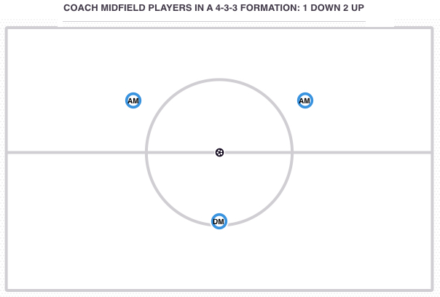
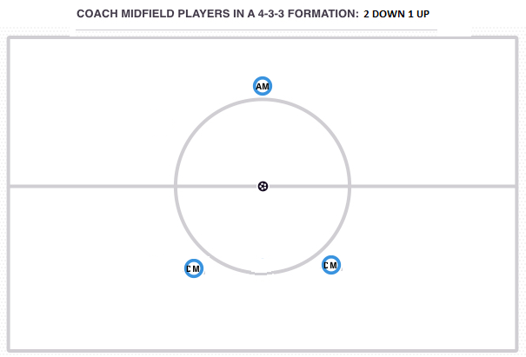
Coaching Midfield in a 4-3-3
Structure
3 x Centre Midfielders make up the midfield unit in the 4-3-3 formation. The unit may be organised in a ‘1 down, 2 up’ arrangement with 1 x Pivot Defensive Midfielder behind 2 x Central Attacking Midfielders.
Alternatively, the midfield may be organised in a ‘2 down, 1 up’ arrangement with 2 x Pivot Centre Midfielders positioned behind 1 x Central Attacking Midfielder. In BP one of the two CM will push high in Attack.
Pivot Defensive Midfield
Game and positional understanding is paramount for the Pivot Defensive Midfielder in the 4-3-3, as this player is responsible for offering defensive stability and breaking down opposition attacks out of possession. When the ball is regained this player should be able to secure and maintain possession, penetrate opposition lines and launch attacks from deep.
As the No. 6 is a key component to play in both defence and attack this player must possess tactical awareness, vision, accurate passing, tackling skills and ability to read the game.
Centre Attacking Midfield
As the Pivot provides defensive cover, the Central Attacking Midfielders can operate as advanced playmakers and look to combine with the front 3 in this system to create and score goals. However, the Central Midfielders must also contribute to defensive duties and stay connected with the pivot out of possession, to compact central areas of the pitch and prevent the opposition penetrating through the middle.
The CM's have responsibilities both in and out of possession to ensure the midfield 3 do not become overloaded and can also contribute to attacks. Therefore, Centre Midfielders must have creativity, tactical awareness, ball retention and passing skills as well as the ability to press and defend.

Slide 77
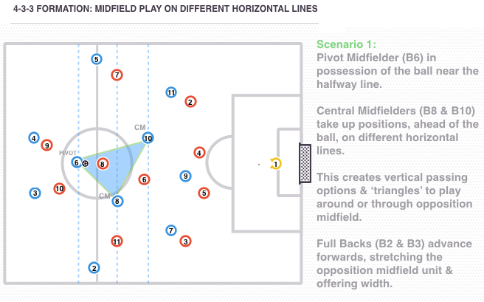
Coaching Midfield in a 4-3-3
In Possession
Midfield play on different horizontal lines
When in possession of the ball, the midfield unit (Blue 6, 8 and 10) should be encouraged to take up positions on different horizontal lines.
Scenario One:
This creates vertical passing options & ‘triangles’ to play around or through the opposition midfield. Rotation between players may occur & options can be provided ahead or behind the ball.
Balance must also be provided with a Central Midfielder always providing an option behind the ball to protect against the opposition counter-attack, normally the Pivot (Blue 6).

Slide 78
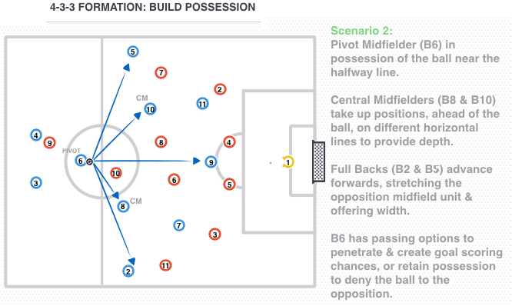
Coaching Midfield in a 4-3-3
Build possession
As possession is secured by the midfield unit and the opposition are in a defensive shape, the aim is to circulate the ball to unbalance the opposition. This will provide opportunities to penetrate and create goal scoring chances, or retain possession to deny the ball to the opposing team.
Scenario Two:
In the above scenario, the Pivot (Blue 6) is in possession as the team offer width through advanced Full Backs (Blue 2 and 3) and depth through Midfielders (Blue 8 and 10) on different horizontal lines, as this stretches the opposition units.
The Pivot (Blue 6) now has passing options to build up play and penetrate the opposition or retain possession to deny them the ball. Passing is multi-directional and the blue team in possession can dictate the tempo based on scoreline, pressure on the ball and stage of the game.

Slide 79
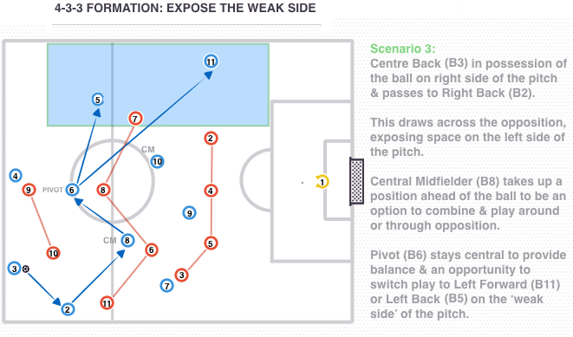
Coaching Midfield in a 4-3-3
Expose the weak side
If the opposition are defensively compact and organised, then the blue team in possession may look to draw them into an area of the pitch and exploit the space created on the ‘weak side’ or in behind.
Scenario Three:
In scenario 3, passing is again multi-directional as the Central Midfielders (Blue 6 and Blue 8) offer close support to provide quick passing options.
Once the opposition are drawn in, the blue team look to play around or through them before switching play to the Left Forward (Blue 11) or Left Back (Blue 5) on the weak side of the pitch.
Passing must be quick and accurate so that the opposition cannot re-adjust and slide across. Balance must also be provided in central areas by the Pivot (Blue 6) in order to switch play and also protect against the counter attack if possession is lost.

Slide 80
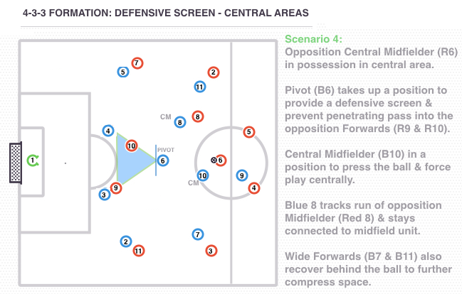
Coaching Midfield in a 4-3-3
Out of Possession
Defensive screen
When possession is lost the midfield unit are also tasked to contribute to defensive duties, with the Pivot Defensive Midfielder (Blue 6) providing a defensive screen to protect the back 4.
Scenario Four:
In central areas, the Pivot (Blue 6) takes up a position to prevent a penetrating pass into the opposition Forwards (Red 9 and Red 10).
Central Midfielders (Blue 8 and Blue 10) must also stay connected to the midfield unit and recover to track opposition runs or press the ball.
If the Pivot (Blue 6) is required to step out and press the ball, rotation occurs and Blue 8 or Blue 10 will drop behind the ball to provide the defensive screen.

Slide 81
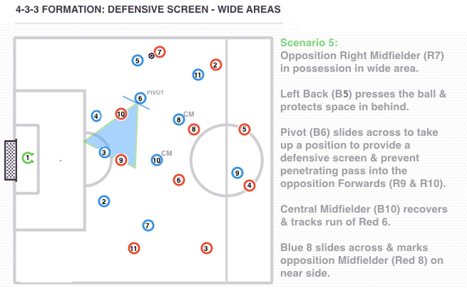
Coaching Midfield in a 4-3-3
Scenario Five:
When the opposition have possession in wide areas, the Pivot (Blue 6) will slide across to protect the back 4 and restrict inside passes into the opposition forwards (Red 9 and Red 10).
In the above scenario, the Left Back (Blue 5) is in a position to press the ball and protect space in behind, whilst the Pivot (Blue 6) is restricting inside passes. Blue 8 is also positioned ball-side of Red 8 to prevent an inside pass to the opposition Central Midfielder.
Therefore, the opposition Right Midfielder (Red 7) only has options to play backwards, where the Blue team can then step out as a unit and press through Blue 11, or attempt to take on the Left Back, who also has cover from Centre Back (Blue 4) to sweep behind.

Slide 82
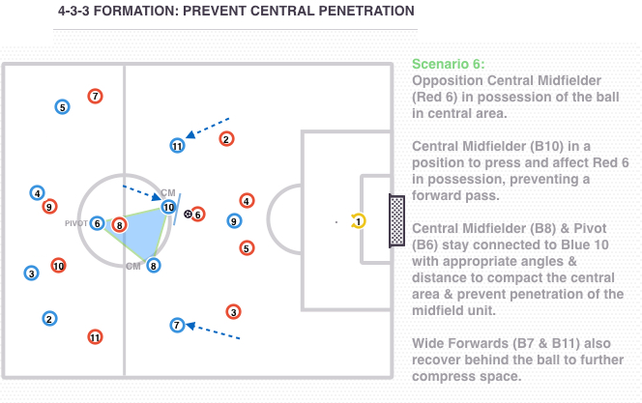
Coaching Midfield in a 4-3-3
Prevent central penetration
As there are only 3 midfielders in this system, it is important that they control and compact central areas when out of possession to prevent central penetration.
Scenario Six:
As the blue team lose possession of the ball there is an immediate reaction and a transition to defend occurs. With the opposition Central Midfielder (Red 6) in possession, the blue Midfielders (Blue 6, 8 & 10) need to make early decisions to press, recover or retreat.
Central Midfielder (Blue 10) is in a position to press and affect Red 6 in possession, delaying forward progress by the opposition and denying penetration through central areas.
The remaining 2 Midfielders (Blue 8 and Blue 6) stay connected to Blue 10 with appropriate angles and distances. This compacts the central area and prevents penetration of the midfield unit.
It also creates time for team mates to recover by deflecting opponents play into safer areas, as the Wide Forwards (Blue 7 and Blue 11) recover behind the ball to further compress space.

Slide 83
Out of Possession
Junior Development Plan
Defensive principles
Midfield (6 – 8 – 10):
Cover the central and lateral defensive midfield area’s
Screen / shield the lines to the strikers
Take over positions, ‘fill’ gaps and stay ‘behind the Third least one of both)
No. 10 Connects with no.6 & no.8 to form a ‘block’ in the midfield Covers the central offensive midfield area, Supports no.9 in pressuring the opponents central defenders
Defensive principles Midfield pointed to the rear :No. 6
Covers the central defensive midfield area
Screens / shields the line to the strikers
Takes over positions,‘fill’ gaps and always stays ‘behind the ball’
Ball Third level ‘winner’ with strong tactical awareness / insight, on field leadership
No’s 8 & 10
Connect with no.6 to form a ‘block’ in the midfield
Cover the lateral midfield area’s
Technical and tactical ‘all round’ midfielders that are able to cover large spaces

Slide 84
Junior Development Plan
Coaching defenders in a 4-3-3

Slide 85
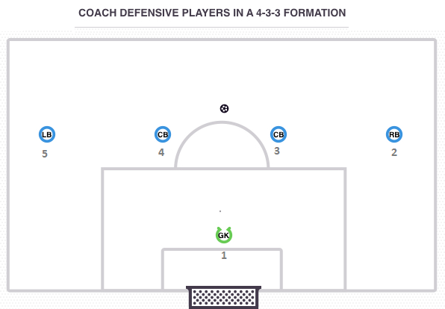
Coaching defenders in a 4-3-3
Here, we look at the 4-3-3 formation and how coaches can deliver the key concepts of the system to your defensive unit, when in possession and out of possession.
Structure
A Goalkeeper 2 x Centre Backs, 1 x Left Back and 1 x Right Back make up the defensive unit in the 4-3-3 formation.
Centre Backs
In a 4-3-3, the Centre Backs are responsible for dominating opposition forwards and providing defensive stability, as well as allowing Full Backs to advance forwards and support the attack as the Centre Backs hold their defensive positions. Many professional teams adopting the 4-3-3 possess a ball-playing Centre Back who can launch the attack from deep and can penetrate the opposition’s first defensive line, in order to move the ball forwards towards the 3 x Central Midfielders and 3 x Forwards.
Full Backs
The role of Full Back in this system is both physically and tactically demanding, as these players are tasked with providing width and must be tactically aware of when and how to overlap/invert to support the attack. Out of possession they are also responsible for protecting and managing space in wide areas, pressuring the opposition winger, and must be comfortable defending in 1 vs. 1 situations to restrict opposition crosses.

Slide 86
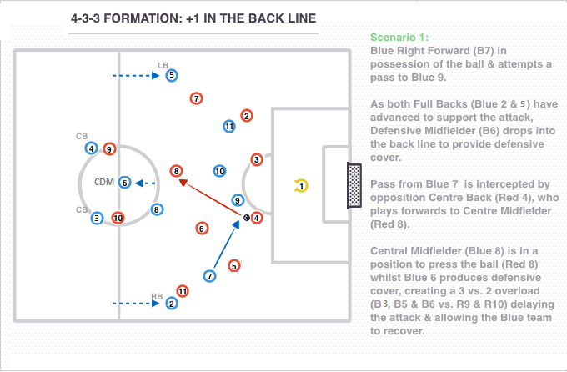
Coaching defenders in a 4-3-3
Out of Possession +1 in the back line (6)
By having tactical flexibility & rotation during the transition to defend stage, or when out of possession, the team can ensure that cover & support is provided in defence by always having 1 more ‘Defender’ than there are opposition Attackers; also known as the +1 Rule (6)
this scenario, the opposition have left 2 Forwards (Red 9 and 10) in advanced positions. As both Full Backs (Blue 2 and 3) have pushed forwards for the blue team, the Defensive Midfielder (Blue 6) drops in to the back line to create a 3 vs. 2 and offer cover when possession is lost, until the team can recover.

Slide 87
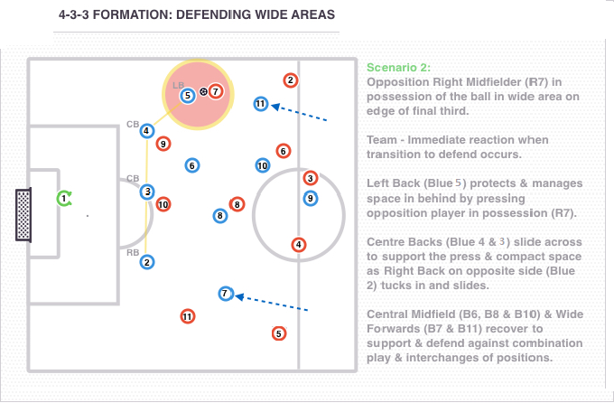
Coaching defenders in a 4-3-3
Defending wide areas
Zonal defending may be adopted by the back 4, with Defenders responsible for filling areas of space and marking any opposition players within those spaces.
Scenario Two:
This approach allows the team to have defensive shape, reduce the physical demands of man-marking, and allows the Full Back (Blue 5) to defend space in wide areas with cover and support provided by the Centre Backs (Blue 4 and 3) and Full Back (Blue 2) on the opposite side.

Slide 88
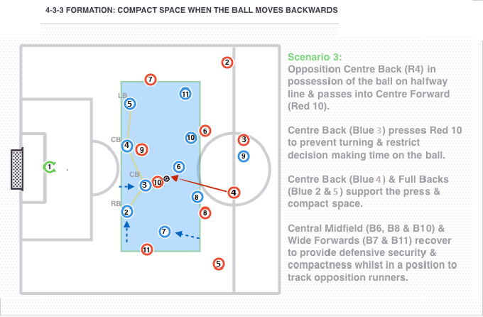
Coaching defenders in a 4-3-3
Compact space when the ball moves backwards
When negative transition occurs and the opposition look to advance up the pitch the Blue team should aim to recover, gain defensive shape and compact the space in order to restrict decision making of players on the ball whilst being in a position to press and affect play.
Scenario Three:
In the above scenario, the opposition (Red team) have penetrated the midfield unit and played the ball into the Centre Forward (Red 10).
This forces the Centre Back (Blue 4) to press the ball whilst the remaining defensive players support the press, stay compact and compress the space.
The positioning of the midfield unit also compacts space to restrict Red 10’s decision making time on the ball and also allows the Midfielders to track opposition runners.

Slide 89
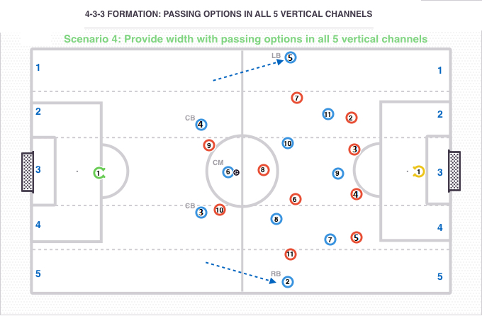
Coaching defenders in a 4-3-3
In Possession
Options in vertical channels (width)
Attacking width in the 4-3-3 system will be provided by the Full Backs (Blue 2 and 3) and the Wide Forwards (Blue 7 and 11). A simple way to deliver this concept to your players is to imagine the pitch divided into 5 x vertical channels and, on gaining possession, the team are encouraged to provide passing option in all 5 vertical channels.
Scenario Four:
In the above scenario, Central Midfielder (Blue 6) is in possession of the ball in vertical channel 3 - central channel.
Options are provided in all 5 vertical channels as the Full Backs (Blue 2 and 5) advance, creating width and depth to the attack whilst stretching the opposition defensive units.
This approach also creates ‘triangles’ & vertical passing options all over the pitch, as Central Midfielders (Blue 8 and 10) offer options to penetrate centrally and the Wide Forwards (Blue 7 and 11) are positioned to receive in the space between the opposition Full Backs and Centre Backs.

Slide 90
Coaching defenders in a 4-3-3
Positioning with team mate on ‘same side’
In order to provide options to penetrate and advance up the field, there also needs to be a positional relationship with team mates on the same side of the pitch. This means that if the Right Back (Blue 2) adopts a position in channel 5, then the Right Forward (Blue 7) takes up a position in channel 4 and vice versa, so that they do not take up each others space and also provide angled passing options.
Dependent on position of the ball
This concept is also dependant on positioning of the ball, for example if the ball is in channel 1 then a passing option does not need to be provided in channel 5 until the ball moves infield and the same the other way around. This is because a direct pass from channel 1 to 5 may be difficult to execute, allows time for the opposition to shift and slide as the ball travels, and if intercepted the player in the far channel may not be able to recover against the opposition's counter attack.

Slide 91
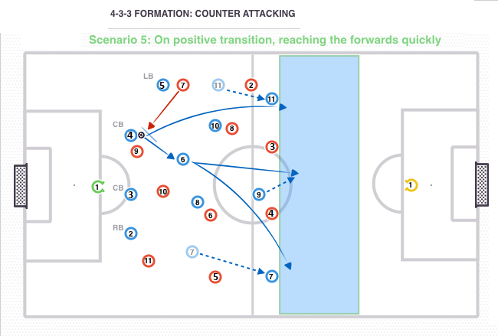
Coaching defenders in a 4-3-3
Counter attack
When positive transition occurs and defenders regain possession, their first option should be to play forwards and exploit space whilst the opposition are still transitioning to defend. This may be through a penetrating pass into space or a ball forward to feet, as the 3 x Forwards force the opposition defensive line as far back as possible.
Scenario Five:
In scenario five, Centre Back (Blue 4) has intercepted a pass from opposition Right Midfield (Red 7). As the red team are still in transition and in an attacking shape, the blue team have the opportunity to utilise the front 3 and counter attack from deep.
This may be through quick combination play and a pass to Central Midfielder (Blue 6) to then play forwards.
Alternatively, the Centre Back (Blue 4) may recognise the opportunity to play into the space behind the opposition defence for the runs of the 3 x Forwards.

Slide 92
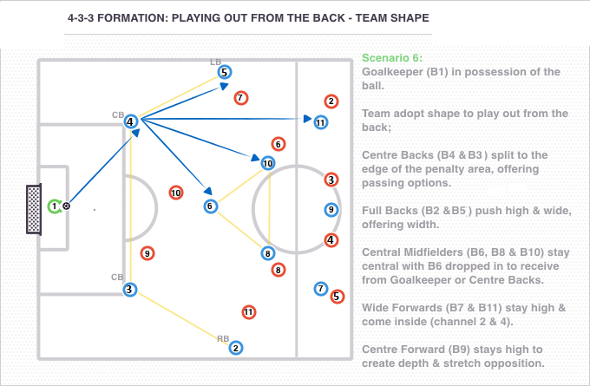
Playing out from the back
As the 4-3-3 system is designed to retain possession and advance up the pitch whilst in control of the ball, playing out from the back is a key concept.
Team shape is key to playing out from the back in a 4-3-3, as the Centre Backs (Blue 4 and 3) split and the Full Backs (Blue 2 and 5) advance forwards to provide width and depth to the attack.

Slide 93
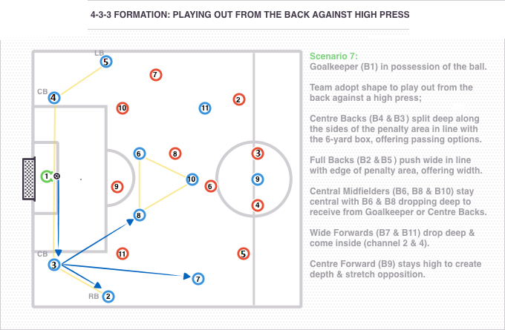
Coaching Playing out from the back in a 4-3-3
Scenario Seven:
If the opposition team decide to press aggressively and high up the pitch, the Centre Backs (Blue 4 and 3) may split deeper and take up a position in line with the 6 yard box. Opposition players will not want to track players into these positions as they can easily be penetrated and then have to recover.
Additionally, the Midfielders (Blue 6 and 8) also drop deep to provide additional support and passing options between the lines to play through the high press.

Slide 94
Junior Development Plan
Set Play Zonal Marking

Slide 95
Three strategies for defending corners: Zonal, Man to Man and Mixed Zonal/Man to Man
Junior Development Plan
Zonal Marking
Zonal marking is where defenders are given responsibility for an area of the pitch (for example, a specific section of the penalty box at corners), whilst defending. Coaches are increasingly using the zonal marking strategy, because it offers better defensive coverage, when implemented properly.
Positives of zonal marking
Defenders are always in position to attack the ball.
Defenders do not get blocked off.
No gaps for the attackers to exploit.
Coaches can put specific players in certain zones (for example, the best header of the ball in the near post zone).
Negatives of zonal marking
Attackers might get a run on the defender.
Players pass on responsibility.
The distance between players needs to be correct (no margin for error).
It takes time to work on this strategy on the training ground.
Requires excellent communication between players.

Slide 96
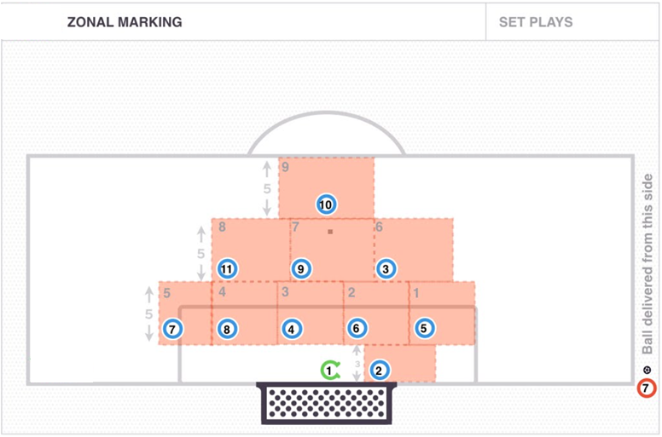
Junior Development Plan

Slide 97
Zonal Marking
Junior Development Plan
Roles and responsibilities
Player 1. GK should command the 6-yard box and prepare to make reaction saves.
Player 2. To stay arms distance away from the front post and make the goal as small as possible for the attacking players. If the opposition play a short corner go and press the ball.
Player 3. Defend zone 6 on line with the near post and the penalty spot. Attack the ball.
Player 4. Defend central zone 3 on the 6-yard box. Attack the ball.
Player 5. Defend zone 1, front post space. Attack the ball. If the opposition play a short corner go and press the ball.
Player 6. Defend zone 2. Attack the ball.
Player 7. Defend zone 5 and back post space. Any corner to the back-post attack the ball.
Player 8. Defend zone 4. Attack the ball.
Player 9. Defend zone 7, penalty spot area. Attack the ball.
Player 10. Edge of the box space. Win any second balls.
Player 11. Defend zone 8. Attack the ball.

Slide 98
Junior Development Plan
Set Play Man-To-Man Marking

Slide 99
Junior Development Plan
Man-To-Man Marking
When using man to man marking, defenders are allocated an opponent to mark (often before the game) either in normal game play or at set-pieces. It is then the defender’s responsibility, when marking a specific player, to always be within touching distance of their opponent and not to give them any space to attack.
Positives of man-to-man marking
Defenders have clear roles and responsibilities.
Does not need a lot of preparation time.
Coaches can match up man for man for example, most capable header of the ball marks the oppositions most dangerous attacker from set pieces or height for height.
Please watch up to 17 seconds of the link below to see how to man mark from corners. Pause on 12 seconds to see the set up.
Negatives of man-to-man marking
Defenders can get blocked off.
Risk of holding shirts and giving away a penalty.
Defenders can lose attackers easily.
Defenders have to watch the player and not just the ball.

Slide 100
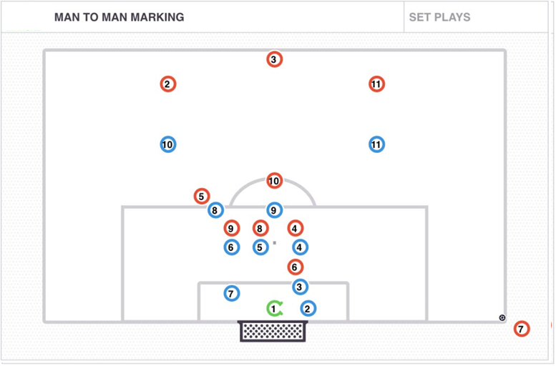
Junior Development Plan

Slide 101
Junior Development Plan
Man-To-Man Marking
Roles and responsibilities
Player 1. GK should command the 6-yard box and prepare to make reaction saves.
Player 2. To stay arms distance away from the post and make the goal as small as possible for the attacking players.
Player 3. Protect the keeper. Mark any opposition player around the keeper.
Player 4, 5, 6, 8, 9. Mark man for man, touch tight and attack the ball.
Player 7. Defend the back post space.
Player 10 11. Edge of the box space. Win any second balls.

Slide 102
Junior Development Plan
Set Play Mixed Zonal and Man to Man marking

Slide 103
Junior Development Plan
Mixed Zonal and Man to Man marking
Mixed zonal and man to man marking is a blend of two different defensive tactics. When using this strategy, a team uses zonal marking and their three or four best defenders to man mark the oppositions most dangerous attackers.
When man marking is unsuccessful, the players defending zonally can attack the ball and the attacker will not get a free attempt on goal.
Positives of mixed zonal and man-to-man marking
By man marking players you are stopping the opposition getting a free run and jump on the zonal defenders.
Still defending key zones with zonal marking.
Man mark the oppositions best headers of the ball and use the zonal players to create a 2v1 defensive overload.

Slide 104
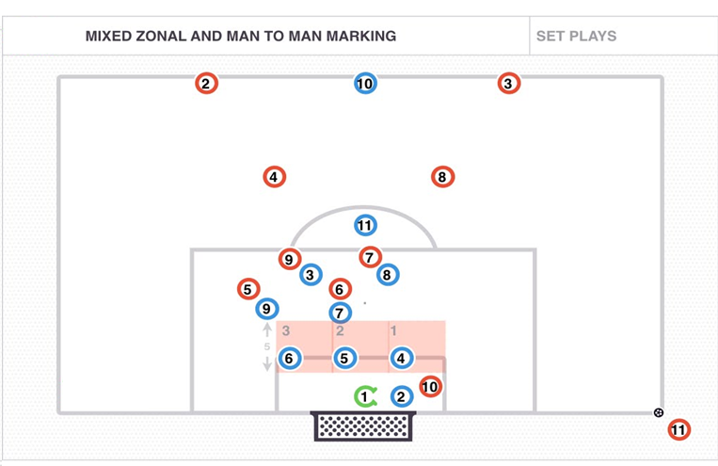
Junior Development Plan
Mixed Zonal and Man to Man marking
Mixed zonal and man to man marking is a blend of two different defensive tactics. When using this strategy, a team uses zonal marking and their three or four best defenders to man mark the oppositions most dangerous attackers.
When man marking is unsuccessful, the players defending zonally can attack the ball and the attacker will not get a free attempt on goal.
Positives of mixed zonal and man-to-man marking
By man marking players you are stopping the opposition getting a free run and jump on the zonal defenders.
Still defending key zones with zonal marking.
Man mark the oppositions best headers of the ball and use the zonal players to create a 2v1 defensive overload.

Slide 105
Junior Development Plan
Roles and responsibilities
Player 1. GK should command the 6-yard box and prepare to make reaction saves.
Player 2. Man mark the player in the near post space (10).
Player 3. Mark man for man (9).
Player 4. Defend zone 1, attack the ball.
Player 5. Defend zone 2, attack the ball.
Player 6. Defend zone 3, attack the ball.
Player 7. Mark man for man (6).
Player 8. Mark man for man (7).
Player 9. Mark man for man (5).
Player 10. Stay on the half way line.
Player 11. Edge of the box space. Win any second balls.

Slide 106
Junior Development Plan
Game Day

Slide 107
Junior Development Plan
IMPORTANT MATCH DAY CONSIDERATIONS
Junior Football games should be viewed in a different context to professional games. The main focus in a professional football game is to win. In junior football, the main focus needs to be fun and development.
Match day is a players chance to put into action what they have learned from practice. It is purely an extension of the training session where transfer of learning should occur.
Players who are over-coached during practice and matches will become robotic and will not be able to make critical game decisions on their own. If the coaches are doing all the talking, the players won’t communicate.
CREATING A GAME DAY CULTURE On game days, the interaction between the following groups should be considered:
Team Coaches
Opponents
Parents
Officials
The following tables provide suggested interaction guidelines between each party. If followed, a player-centered culture of respect should be created.

Slide 108
Junior Development Plan
(1) TEAM COACHES (Includes Parent Coaches and Trainers)
INTERACTION AREA | COACH EXPECTATIONS
PLAYERS | • Verbal instructions should be carefully measured to provide players with the necessary information they need to improve without over-coaching or joy-sticking players.
OFFICIALS | • The officials’ decisions should be respected and unchallenged. No attempt should be made to influence their decisions or the outcome of the game.
PARENTS | • Parents should be engaged in the educational process. If possible, parents should be debriefed to ensure they understand post game goals and areas for discussion with their children.
OPPOSITION | • Sportsmanship and fair play should be of the utmost importance. Respect for the opposition’s coaches, their players and parents ensures a supportive environment for both sets of players.

Slide 109
Junior Development Plan
(2) PARENTS
INTERACTION AREA | PARENT CONDUCT
TEAM COACH | • Parents and team coaches should be on the same page with regards to the team’s seasonal objectives, which should be communicated during preseason. • Parents should avoid questioning or confronting the team coach during or immediately after a game. Where appropriate parents should call or email the team coach to discuss the issue.
PLAYERS | • Be supportive but don’t coach from the sidelines. Let the coaches communicate important information to avoid confusing players. A parent’s role should be to provide support and encouragement. If parents are over communicating, it takes away the opportunity for players to communicate with each other. • Avoid defining success and failure in terms of winning and losing. For each game, the coach will have defined skill acquisition goals for the team. These are the objectives that should be used to measure success. This will teach players to have a better perspective on the game experience.
REFEREE | • Parents should not question or try to influence a referee’s decision for any reason. Mistakes will happen; parents should be a role model for their players. Any communication to the referee should be via the team coach.
OPPOSITION | • Parent’s interaction with players from the opposite team should only ever be positive and sportsmanlike in nature. Parents should never get involved in any type of verbal confrontation or dispute with parents and players of the opposing team, whatever the reason.

Slide 110
Junior Development Plan
(3) PLAYERS
INTERACTION AREA | PLAYER EXPECTATIONS
COACHES | • Respect the decisions of the team coach with regards to playing time and position as well as substitutions. • Players should have an open and inquisitive mind when receiving feedback from the coach. Players should be encouraged to implement feedback where applicable.
TEAMMATES | • Encourage other players on your team and support decisions of teammates regardless of the outcome.
OFFICIALS | • Players should not question or argue with a referee’s decision for any reason. Mistakes will happen; players should respect the decision and continue with the game.
OPPOSITION | • Fair play and good sportsmanship should be an integral part of all interactions with opposition players. Shake hands and congratulate all players on a good game upon completion of the match.
PARENTS | • Players should not look to their parents during the game for feedback or information on their self-performance. Players should focus on the game and their own performance with no distraction. • Players should keep their parents informed of important information that the coach has relayed after the game. This may include logistical information for future training session or games and player development information that relates to focused areas of improvement.

Slide 111
Junior Development Plan
(4) Game Day Under 9-12
 | GAME DAY TIME FRAME GUIDANCE FOR AN 11.00AM KICK OFF
TIME FRAME | • 9.45am-10am – Arrive at the ground • 10.10am – Gather team together. (Name starting TEAM and substitutes) • 10.15am - Players get changed. (If not changed already.) • 10.30am – Team talk – Core Skill for the day - individual and team (Start warm up.) • 10.50am – Finish warm up (Final team talk on CORE SKILL) • 10.55am – Players organised-focused and ready to play (Player’s team huddle (self motivation) • 11.00am – Kick off • 11.30am – H/T Team talk – Core Skill for the day – POSTIVE individual and team feedback (Let them play.) • 12.00pm – F/T Team talk – POSTIVE individual and team feedback (Send them home happy.) Hopefully all of the above may be of some help when it comes to game day.

Slide 112
Junior Development Plan
(4) Game Day Under 13-16
 | GAME DAY TIME FRAME GUIDANCE FOR AN 11.00AM KICK OFF
TIME FRAME | • 9.45am-10am – Arrive at the ground • 10.10am – Gather team together. (Name starting XI and substitutes) • 10.15am - Players get changed. (Team sheet filled out, checked and handed in.) • 10.30am – Team talk – Tactics - individual and team (Start warm up.) • 10.50am – Finish warm up (Final team talk) • 10.55am – Players organised-focused and ready to play (Player’s team huddle (self motivation) • 11.00am – Kick off • 11.30am – H/T Team talk – Team Task for the day – POSTIVE individual and team feedback (Let them play.) • 12.00pm – F/T Team talk – POSTIVE individual and team feedback (Send them home happy.) Hopefully all of the above may be of some help when it comes to game day.

Slide 113
Junior Development Plan
Junior Development Policy

Slide 114
Junior Development Policy
Junior Development Policy
Game Day Behaviours
Sideline instructions by coaches and parents on game day should be minimal so that players are not overloaded with information and are allowed to experiment and find solutions themselves to the all the football problems presented on the football field on game day
If young players are not given the chance to make their own decisions or the opportunity to discover football solutions without external intervention, the learning environment will not be optimal to allow individual player flare and imagination to flourish and players subjected to constant external instruction and direction often lack imagination and become rigid and predictable in the long-term
Studies indicate decision making skills, imagination and the players’ overall awareness on the football field are the strongest indicators that young players will progress in the game to the professional status and these attributes are best fostered by allowing players to experiment and discover football solution on their own
Excessive instruction from coaches on game day to players during the game should be avoided because:
it denies players the opportunity to show what they know (because the coach is constantly yelling instructions to tell them);it prevents the coach from evaluating what players have learnt and are capable of doing; and most importantly, it prevents players from developing perception and decision making skill which are critical for long term success
Parents should also avoid yelling instructions to their children and their team given the detrimental effect it has to the learning process

Slide 115
Youth Development Policy
Junior Development Policy
Parents Dealing With Mistakes
It must be expected that players, many of whom are struggling to execute fundamental skills and techniques, will in their formative years of development often make mistakes
Mistakes should be reacted to positively by coaches and parents and it should be constantly reinforced to players and parents that making mistakes and recognising them are essential to the learning process and player development
Dealing with player mistakes negatively, for example by shouting, being sarcastic, belittling, threatening to substitute a player or displaying poor body language is detrimental to a players long term development and is condoned
Players should be encouraged to experiment, take risks and attempt creative skills and ideas without out fear and this can only occur when everyone is aware that things can break down and players will make mistakes during this process and this is ok and a prerequisite for player progression
It is much more beneficial for player understanding and learning when players themselves discover what went wrong and that’s why FGC advocates the Guided Discovery descriptive approach of coaching where by coaches guide a player to discover solutions to football problems rather than the prescriptive directive approach

Slide 116
Youth Development Policy
Junior Development Policy
Playing Time
As a long term player development philosophy that is focused on the individual development of every player to maximise their full potential, it is important that each and every player be given adequate opportunity to develop
The policy is for all players in the Discovery Phase, Skill Acquisition Phase and Game Training Phase (ie. players aged 5 – 16) is that all players must have approximately equal playing game time.
It is also recommended by FGC that all players in the Discovery Phase, Skill Acquisition Phase and Game Training Phase also have an approximately equal number of games.
Each team IS required to maintain their own system of record for monitoring player game time and be prepared to submit this to the Junior Director of Coaching / Technical Director on request

Slide 117
Youth Development Policy
Junior Development Policy
Player Identification & Selection
The policy for identifying and selecting players for teams is based on the premise that everyone has potential, regardless of the their current ability or current physical attributes and therefore the focus must be on what the player can do in the future (a long-term approach) and not only what the player can do today (a short-term approach)
Taking a longer-term vision for player development involves patience, sensible progression and realistic expectations and this approach will provide a higher percentage of youth players the opportunity to enjoy football as well as learn and develop a passion for the game, which are the main priority.
Parents, players and coaches must not be too concerned with a players level of performance at a given age compared with the ability of other children at a similar age, but rather they should take comfort in the knowledge that all players develop at different rates and that every child playing youth football has inner-potential that can be developed
There are many examples of players who were more advanced and further developed at younger ages compared to the majority and expected to go onto elite and professional levels but faded away and many other examples of players who were less advanced at younger ages and rapidly developed during later years to surpass players that were once more advanced (such players are often referred to as ‘later developers’)
To ensure that youth players are grouped together with other players at similar levels of development and that players play matches in competitions that will provide each player with an adequate level of challenge to maximise their longer term development, FGC will conduct regular trials to evaluate and asses player development
During player trials, the Director of Coaching / Technical Director and a panel of qualified FGC coaches will assess and evaluate players based on a long-term approach (ie. what the player can do and develop into in the future) and this process will be enabled using a player evaluation template aligned with this Youth Development Policy and the Football Way Curriculum

Slide 118
Youth Development Policy
Junior Development Policy
Player Identification & Selection
In addition to the player’s performance during trials, consideration will be given to the progress of the players development from previous years as documented in the Player Assessments undertaken by coaches each year.
As Mudgeeraba takes a long-term view of player development and has a policy to develop from within the club rather than continually recruiting external players, it is expected there will not be large scale turnover of players in graded teams as new players trial however there will be minor movements in and out of teams to reflect the different stages of player development
In addition to the trial process for identifying and selecting players and allocating them to teams and competitions that will provide them with an optimal level of challenge, the Junior Director of Coaching / Technical Director will also maintain a Player Identification ‘Watch-List’ noting players to be considered for moving into a different team / level that is more suitable given the current stage of development and this Mudgeeraba Soccer Club Youth Development Policy
All selection and player identification decisions will be made based on the long-term player development philosophy described in this Youth Development Policy and all final decisions on players will rest with the Junior Director of Coaching / Technical Director

